Slide 1


Literature review
on Infection Prevention and Control
Gabriel BIRGAND
EUCIC Clinical Coordinator

Slide 2
Topics addressed
Sequencing and automated surveillance
Candidozyma auris
Clostridioides difficile infections
Catheter line infections and ICU acquired pneumonia
Healthcare associated respiratory infections and PPE
HAI in Nursing homes and LTCFs
Healthcare associated Malaria

Slide 3
Topics addressed
Sequencing and automated surveillance
Candidozyma auris
Clostridioides difficile infections
Catheter line infections and ICU acquired pneumonia
Healthcare associated respiratory infections and PPE
HAI in Nursing homes and LTCFs
Healthcare associated Malaria

Slide 4

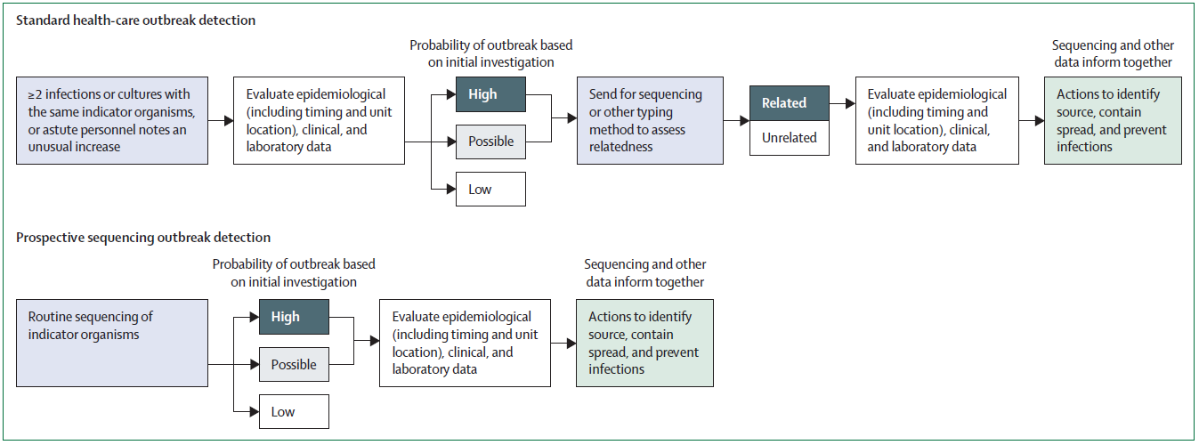
Framework towards implementation of sequencing for AMR & other HC-associated pathogens
Standard healthcare outbreak detection
Prospective sequencing outbreak detection (Sequence-first)
NGS will continue to grow
Polyclonal/multi-species HAI outbreaks, promiscuous mobile genetic
Collaboration and infrastructure
Resource burden, sustainability, and limitations on standardisation
Alison Laufer Halpin Lancet Infect Dis 2025 January 17, 2025 https://doi.org/10.1016/S1473-3099(24)00729-1

Slide 5

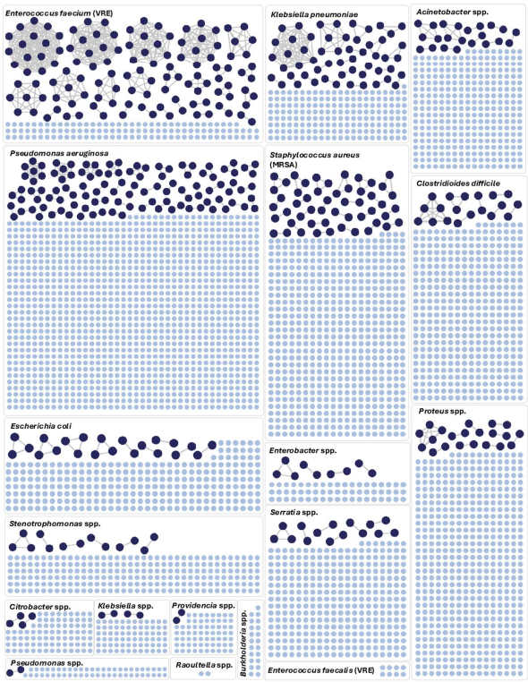
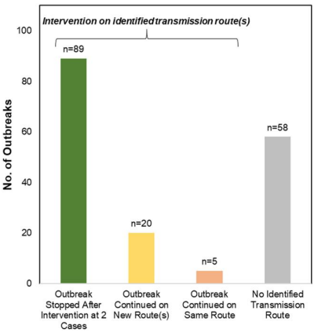
Real-Time Genomic Surveillance for Enhanced Healthcare Outbreak Detection and Control
UPMC Presbyterian Hospital, Weekly WGS on HA clinical bacterial isolates, 2021-2023
K.p.
A.b.
VRE
172 outbreaks (2–16 pts)
476/3921 (12%) isolates,
292 (61%) epidemiological link
Same endoscope (9 outb.), Ventilators (3)
Wound care (1 VRE)
P.a.
MRSA
C.diff
62 infections & 4.8 deaths avoided
Net cost savings: $695,706, 3-fold return/invest
E.coli.
Prot.
Demonstration of feasibility and effectiveness of integrating genomic surveillance into routine infection prevention practice
Serr.
Sundermann et al Clinical Infectious Diseases, 30 April 2025, https://doi.org/10.1093/cid/ciaf216

Slide 6

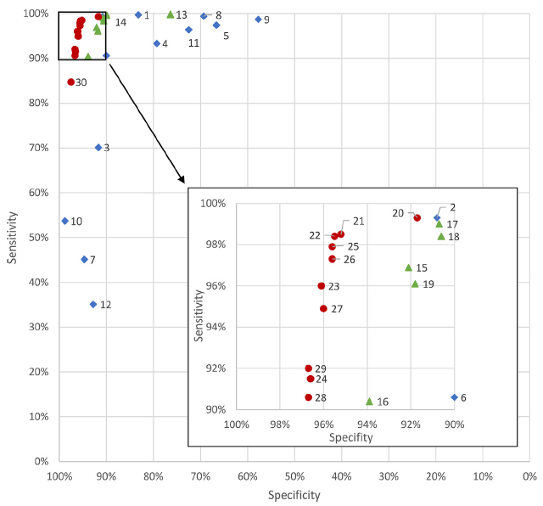

Selection algorithms for a non-ventilator hospital-acquired pneumonia semi-automated surveillance
Sensitivity, specificity, workload reduction of semi-automated nvHAP surveillance
Dataset: 157 902 pats discharges, 947 nvHAP (ECDC)
Algorithm: Indicators alone or combined, lit. + experts opinion
Radio, vital signs, blood test, medication, bacterio, virologic sampling
Present >48 hours after admission or anytime if readmitted within 10 days
Sensitivity:
Single indic: 35% oxygen desaturation → 99.7% radio of chest
Simple algo: 99.6% Radio + abn WBC or fever
Complex algo: 99.3% “radio+ abn WBC or fever → Highest workload ↘
ICD-10 codes for HAP: 54%
Assist hospitals or stakeholders
of surveillance initiatives in developing algorithms
customized to their local conditions
A. Mueller et al. / Clinical Microbiology and Infection 31 (2025) 582-587 https://doi.org/10.1016/j.cmi.2025.01.015.

Slide 7

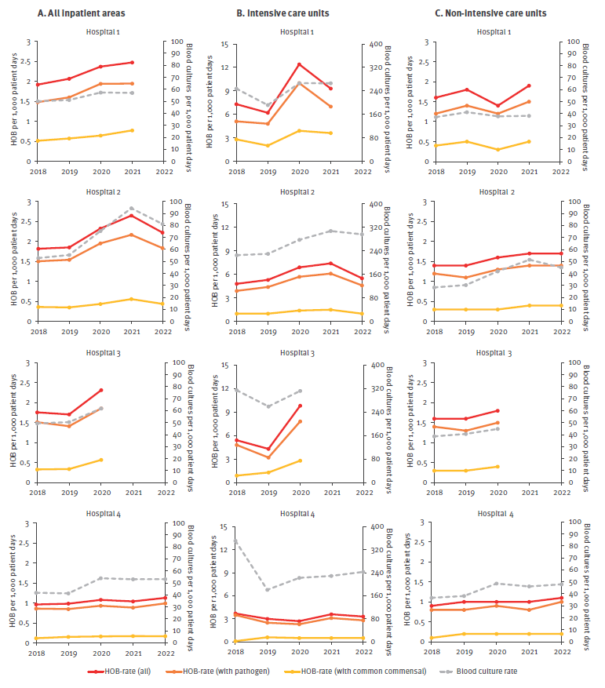
Hospital-onset bacteraemia and fungaemia as a novel automated surveillance indicator
Algorithm & dataset for automated surveillance, retrospective analysis,4 hospitals, NETH, GER, SWDN, SWTZ (2018–22)
All inpatients
ICU
Non-ICU
1
Consensus definition:
1 blood cult + & pathogen ≥2 days admi
2 blood cult + same commensal in 2 days
2
1–2.2/1000 PD HOB
Comparable between hospitals
Consistency over time
ICU>non-ICU
HOB with pathogen
Enterococci in ICU
Enterobacterales in non-ICU
Staphylococcus aureus: 8–16%
15–28%
HOB with commensal
3
Feasibility of developing/applying consensus definition for fully automated surveillance of HOB in 4 European hospitals
Provide detailed guidance for future implementation.
4
Seven JS Aghdassi, Euro Surveill. 2025;30(24):pii=2400613. https://doi.org/10.2807/1560-7917.ES.2025.30.24.2400613

Slide 8
Topics addressed
Sequencing and automated surveillance
Candidozyma auris
Clostridioides difficile infections
Catheter line infections and ICU acquired pneumonia
Healthcare associated respiratory infections and PPE
HAI in Nursing homes and LTCFs
Healthcare associated Malaria

Slide 9

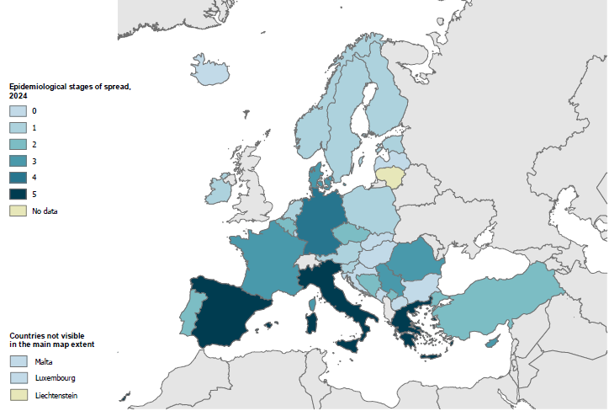
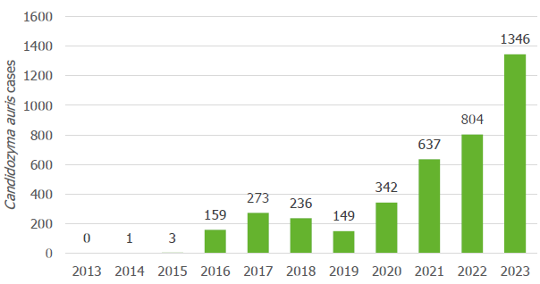
Epidemiological situation, laboratory capacity and preparedness for Candidozyma (Candida) auris, 2024
18 countries
Distinct outbreaks in 3 countries: Cyprus, France, Germany
Endemicity in 4 countries: Greece, Italy, Romania, Spain
Period between 1st case in country & regional endemicity: 5 to 7 years
Ref Myco Lab in most countries
17/36 national surveillance system
15/36 with national IPC guidance
ECDC, 11 September 2025

Slide 10
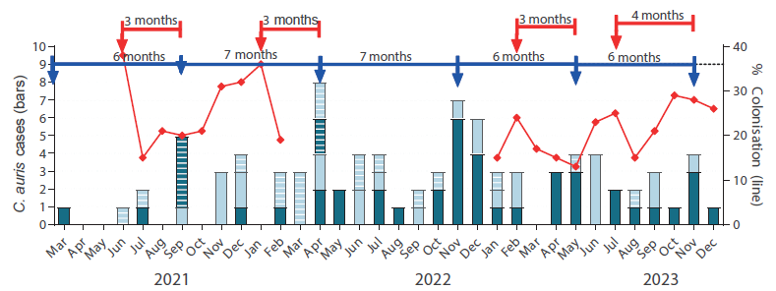
Epidemiological situation, laboratory capacity and preparedness for Candidozyma (Candida) auris, 2024
3-year: Mar 2021-Dec 2023 still ongoing
89 C. auris-driven episodes
5 waves every 6-7 months
following ↗ colonisation rates / 3–4 months
1 BSI per 5 to 10 new colonisation/month
3 months
Control measures:
Active screening in ICU, contact + admi & discharge
Axilla + groin, selective broth + chromogenic media
Single room, dedicated equipment/staff
Baths with chlorhexidine before discharge
Environmental cleaning: 5,000 ppm chlorine
Isolates clade I, genetically related, 84% fluconazole-R
ICU reflected burden of hospital
Screening on admission of patients exposed in endemic areas
Prompt implementation of antifungal stewardship
Meletiadis et al. Euro Surveill. 2024;29(45):pii=2400128. https://doi.org/10.2807/1560-7917.ES.2024.29.45.2400128

Slide 11
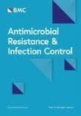
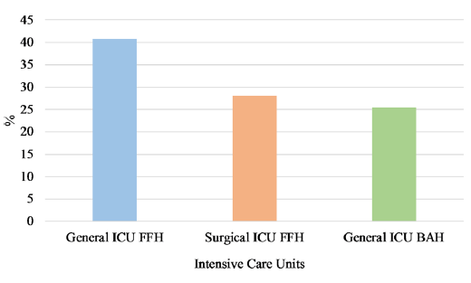
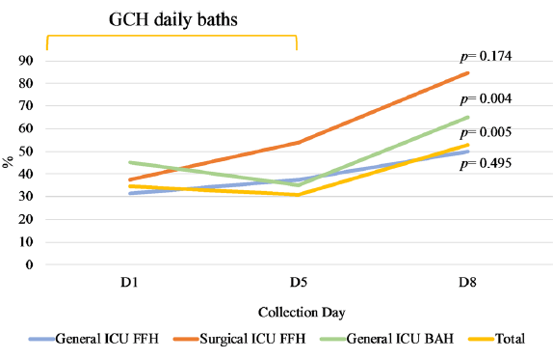
Can chlorhexidine gluconate baths reduce fungal colonisation in ICU patients?
Distribution of patients colonised by fungi
Lisbon, 2 tertiary large hospitals, 2020 to 2022
988 Axillary/inguinal swabs, 3 ICU: D1: 675; D5: 203; D8: 110
Daily CHG bathing:
D1-D5: 2% wipes or 4% solution; D6-D8: soap-and-water
34% colonised by yeast (15% acquired, 29% persistent)
89 patients monitored longitudinally
Transient ↘ D1–D5 & ↗ D6-D8 soap-and-water
Fungal colonisation profile throughout the entire LOS
Not effective ↘ acquisition or decolonisation of Candida spp.
CHG protocols need additional/alternative antifungal strategies
Species-specific responses → tailored approaches
RCT, standardized exposure, broader sampling, multiple body sites
Nascimento et al. Antimicrobial Resistance & Infection Control (2025) 14:87 https://doi.org/10.1186/s13756-025-01606-6

Slide 12

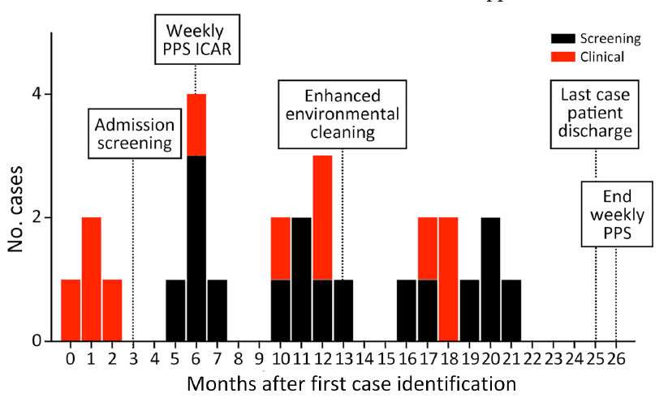
Candida auris Outbreak and Epidemiologic Response in Burn Intensive Care Unit
10-bed ICU, pediatric and adult burn patients
8 patients colonized or infected over 2 years
Breaches:
Hand hygiene:78-93%, 32% transporters, 35% food services
PPE donning/doffing, environmental cleaning, shared equipment
Outbreak Mitigation Measures
Contact precautions + signs on doors
Focus on environmental cleaning (Bleach+UV) & hand hygiene
Barbian et al, Emerging Infectious Diseases • www.cdc.gov/eid • Vol. 31, No. 3, March 2025

Slide 13
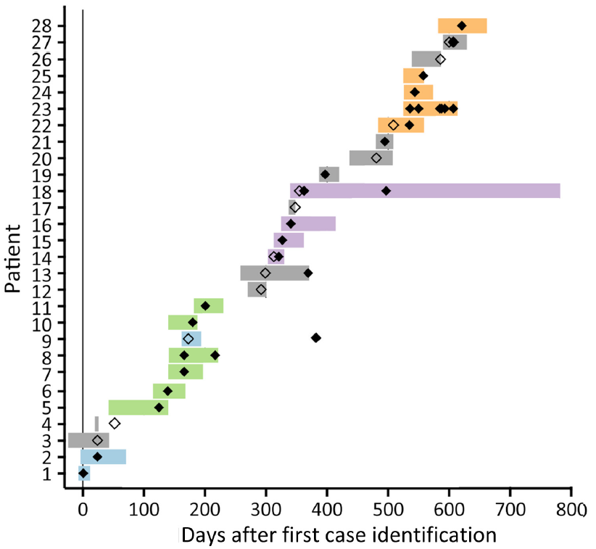
Candida auris Outbreak and Epidemiologic Response in Burn Intensive Care Unit
Genomic and Epidemiologic Investigation
Multiple independent intro from regional C. auris → Within-unit spread
C. auris imported from elsewhere in the facility
→ Contaminated HCP hands, clothing, shared equipment.
Acquisition from contaminated surfaces/equipment in common area outside BICU
Axilla or groin screening at admission → Sensitivity ≈62%
>6 body sites needed to detect 100% of colonized patients
Cluster 4
Cluster 3
Cluster 2
Possible role of ancillary personnel moving throughout the hospital
→ IPC not just on within-unit
Admission screening + point prevalence survey needed to identify and isolate colonized patients quickly
Cluster 1
Barbian et al, Emerging Infectious Diseases • www.cdc.gov/eid • Vol. 31, No. 3, March 2025

Slide 14
Topics addressed
Sequencing and automated surveillance
Candidozyma auris
Clostridioides difficile infections
Catheter line infections and ICU acquired pneumonia
Healthcare associated respiratory infections and PPE
HAI in Nursing homes and LTCFs
Healthcare associated Malaria

Slide 15

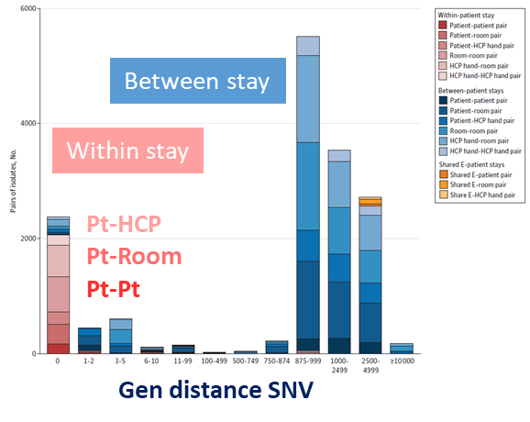
Environmental and Health Care Personnel Sampling & Unobserved Clostridium difficile Transmission in ICU
2018, 13-week longitudinal, observational study, 2 ICUs in Utah
7000 Daily sampling + Cult: 177 body sites, room surfaces, HCP hands
1.7% toxigenic C difficile, 0.6% acquisition
8% linked to other admissions vs 57% non overlapping
3.3% (9/274) surfaces positive
TAT Conta. patient → room surfaces: 0.8 (1.6) days
TAT Conta. patient → to HCP hand: 1.5 (2.08) days
Clusters of 22 occupant stays
→ 5 instances of contaminated HCP hands moving C difficile between rooms
Nosocomial transmission not primary source of acquisition
→ hand hygiene and environmental decontamination
Most isolates nontoxigenic
3.6-fold higher C difficile movement identified through environment sampling
Lindsay T. Keegan et al, JAMA Network Open. 2025;8(4):e252787. doi:10.1001/jamanetworkopen.2025.2787

Slide 16
Topics addressed
Sequencing and automated surveillance
Candidozyma auris
Clostridioides difficile infections
Catheter line infections and ICU acquired pneumonia
Healthcare associated respiratory infections and PPE
HAI in Nursing homes and LTCFs
Healthcare associated Malaria

Slide 17

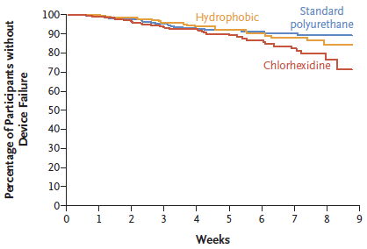
A Comparison of Peripherally Inserted Central Catheter Materials
Randomized, controlled, superiority trial, 3 Australian hospitals, Sept 2019-Dec 2022
1098 Adults & children with PICC placement, 1:1:1 Hydrophobic / chlorhexidine / standard polyurethane
8 weeks follow-up for device failure, composite :
Infectious: bloodstream, local
Noninfectious: thrombosis, breakage, occlusion
0.9 (0.5-1.8)
1.7 (0.9-3)
1098 participants | Hydrophobic N= 365 | Chlorhexidine N= 365 | Stand. Polyurethane N=368
Device failure | 21 (5.9%) | 36 (9.9%) | 22 (6.1%)
Infectious failure | 5 (1.4%) | 4 (1.1%) | 6 (1.7%)
PICC-associated BSI | 5 (1.4%) | 6 (1.7%) | 7 (1.9%)
Local infection | 6 (1.7%) | 10 (2.8%) | 7 (1.9%)
Catheter complete and partial occlusion > with Chlorhexidine / hydrophobic or standard polyurethane
Trial conducted during the pandemic → Bias?
Practitioners performing insertions unfamiliar with PICC products and kits
Occlusion = most common reason:
17% hydroph., 34% chlorhex., 14% sd-polyur.
Ullman et al, N Engl J Med 2025;392:161-72. DOI: 10.1056/NEJMoa2406815

Slide 18

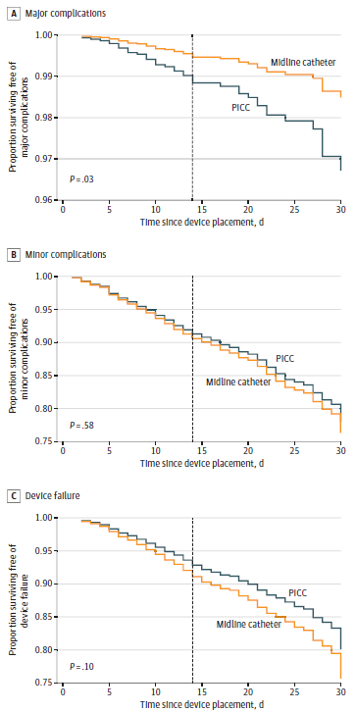
Midline vs Peripherally Inserted Central Catheter for Outpatient Parenteral Antimicrobial Therapy
Major complication, p<0.3
Comparison Midline vs PICC Pts with antimicrobial therapy
Retrospective cohort study, 2017-2023, 69 Michigan hospitals
CRBSI, or CR-venous thromboembolism
2824 included patients | Midline 999 (71%) | PICCs 825 (29%) | aHR
Median (IQR) dwell time, days | 12 (8-17) | 19 (12-27) | P < .001
Major device complication | 16 (0.8%) | 28 (3%) | 0.4; 0.2-0.9
Device dwell ≤14 days | 12 (0.9%) | 16 (5%) | 0.3; 0.1-0.7
Device dwell >14 days | 4 (0.6%) | 12 (2%) | 0.4; 0.1-1.4
Minor complications/failure | 206 (10%) | 114 (14%) | 1.1; 0.8-1.4
Device dwell ≤14 days | 151, 11.4% | 52/304 (17%) | 0.8; 0.6-1.1
Minor complication, p=0.58
catheter dislodgement, occlusion, tip migration, infiltration, superficial thrombophlebitis, exit site concerns
Device failure, p=0.1
Midline catheters appeared to be safe alternatives to PICCs for OPAT, particularly if infusions were planned for 14 or fewer days
catheter removal following device
David Paje et al, JAMA Intern Med. doi:10.1001/jamainternmed.2024.5984

Slide 19
Impact of Pseudomonas aeruginosa carriage on ICU acquired pneumonia
Objective: To determine incidence of P.a. ICU pneumonia, association with P.a. colonization
8.1/1000 days in colonized vs 1.3 in non-colonized
Adult patients on MV admission, 30 ICUs, 11 EU countries
Sample perianal & lower respiratory ≤72h after admi & 2/week
1971 subjects: 10.4% colonized ≤72 hours (3/4 perianal)
7% acquisition (6-4 days)
43 (1.8%) P.a. pneumoniae, 1.7 events/1000 days
11 (26%) colonized, 9 (21%) acquired
Outcome, CSHRa (95% CI) |  | P.a. pneu. | ICU death
Early colonization | Perianal | 2.5 (1-7) | 1 (0.6-1.5)
 | Respiratory | 8 (3-19) | 2 (1.1-3.4)
Colonization anytime | Perianal | 4.6 (1.8-12.2) | 1 (0.8-1.5)
 | Respiratory | 5.2 (2.3-11.9) | 2 (1.1-2.7)
6-fold PAIP if respiratory carriage, 2-fold for perianal; 1 country with high rate and high-risk clone & men
Gut-to-lung translocation → skin or micro-aspiration of gastric; Eradication or prevention carriage: SDD/SOD, pre-emptive interventions
C. Recanatini Clinical Microbiology and Infection 31 (2025) 433e440

Slide 20
Topics addressed
Sequencing and automated surveillance
Candidozyma auris
Clostridioides difficile infections
Catheter line infections and ICU acquired pneumonia
Healthcare associated respiratory infections and PPE
HAI in Nursing homes and LTCFs
Healthcare associated Malaria

Slide 21
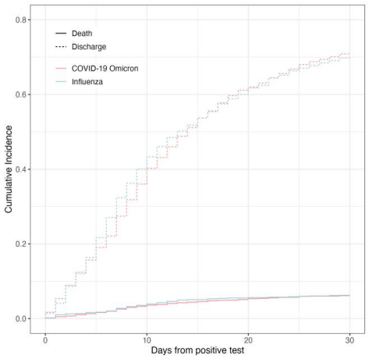
In-hospital Outcomes of Healthcare-associated Coronavirus Disease 2019 (Omicron) Versus Healthcare-associated Influenza
Retrospective cohort study, nationwide hospitalized patients with symptomatic HA-COVID-19 or influenza, 9 tertiary care and large regional hospitals Switzerland
HR Flu in-hospital death vs COVID-19:
0.94 (0.7-1.3, p=0.70)
Adults hospitalized for ≥3 days
COVID-19 or influenza : symptoms + RT-PCR
2901 COVID-19: 2022-2023 vs 868 Flu: 2018-2023
Outcomes: 30-day in-hospital mortality & ICU admission
Cox regression
 | COVID-19 Omicron n = 2901 | Influenza n = 868 | p
In-hospital death, all causes | 181 (6) | 53 (6)
Admission to ICU | 70 (2) | 23 (3) | 0.78
Any complications | 824/2811 (29) | 289/819 (35) | <0.01
Remained NS in sensitivity analysis, > 10 days after hospital admission
Lower risk of discharge among the COVID-19 unvaccinated, NS death
Flu vaccination, antiviral treatments ?
Comparable risk → Same IPC measures
Rebecca Grant et al. Clin Infect Dis. 2024 Nov 13:ciae558. doi: 10.1093/cid/ciae558.

Slide 22
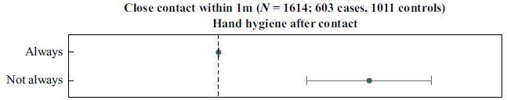

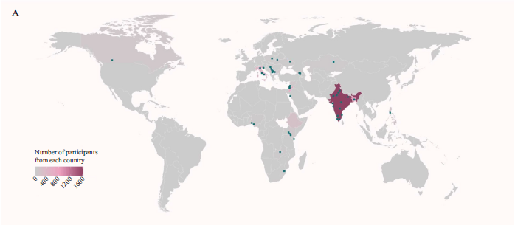


Risk factors for SARS-CoV-2 infection in health workers
Global multi-centre nested case-control study, 121 HCF in 21 countries, June 2020-Dec 2021
1213 HCW: direct/indirect care for COVID-19 patient in prior 14 days
1844 Controls: same facilities & exposure, serology neg
Serological testing + questionnaire, baseline & 3-4 weeks
Exclusion if SARS-CoV-2 vaccine >14 days
Close contact within 1m
HH after contact
Not always
AGP
Body fluids
>15 min
Contact with contaminated materials
Clothes
Med. devices
Personnal items
Contact with contaminated surfaces
Bathroom
Bed
Dinning table
Med gas panel
Pts table
Ward corridor
A. Cassini et al. / Journal of Hospital Infection 155 (2025) 40e50

Slide 23

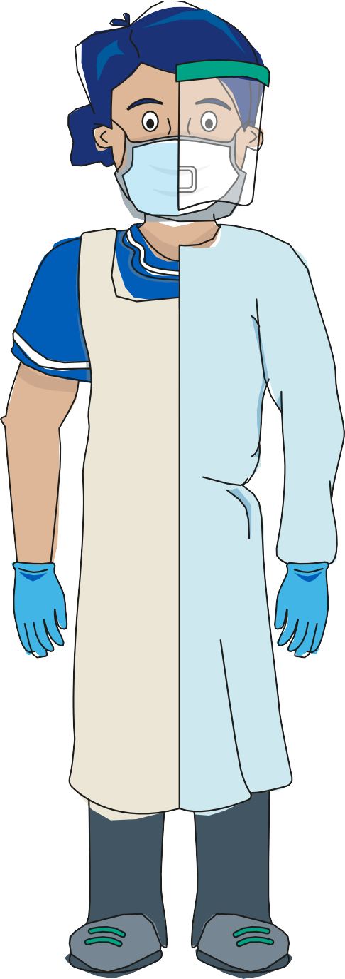
Role of gowns in preventing nosocomial transmission of respiratory viruses
To assess the use of long-sleeved gowns and clothing worn by HCW during care of patients with respiratory viruses to prevent nosocomial transmission
14% Hood
Systematic review, 30 articles
0-77.5% PCR+ (half = 0%) Clothing after patient care, no impact of AGP
3/7 studies: virus remained infectious
Coveralls (7-14 days), plastic gowns (6 days), cotton (3 days -4 hours), polyester (2.5 hours)
2/7 studies: protective effect on infection of HCW protective clothing
3/4 studies: short-sleeves, cotton gowns or no gowns provided = level of protection as standard gowns
19% Torso
12% Sleeves
Protective effect of long-sleeved gowns / alternatives still insufficient
Short-sleeved gowns + hand and arm hygiene = Safe alternative options
→ Sufficient to eliminate 12% of contamination
Viable viruses transmitted from standard uniforms to patients?
Viruses adhere to protective clothing → completely discontinuing use of gowns?
15%
Foot dorsum
Laura M. Orsel et al, Journal of Hospital Infection 2025, https://doi.org/10.1016/j.jhin.2025.05.023

Slide 24
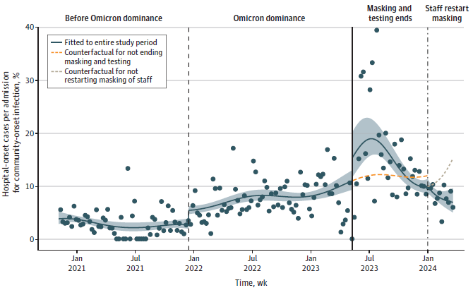
Testing and Masking Policies and Hospital-Onset Respiratory Viral Infections
Is systematic test on admission + masking associated with changes in relative incidence of hospital-onset SARS-CoV-2, influenza, and RSV?
Weekly hospital / community-onset
Ten hospitals , Mass General Brigham US,
30 071 community & 2075 hospital-onset SARS-CoV-2, influenza, and RSV infections
2.9%
8% (6-9)
15% (14-17)
8% (5-11)
Counterfactual for not restarting
Stopping universal masking and testing associated with ↗ hospital-onset RVI relative to community infections
Restarting masking of HCW associated with ↘ particularly when community incidence ↗
Counterfactual for not ending
Theodore R. Pak et al, JAMA Network Open. 2024;7(11):e2448063. doi:10.1001/jamanetworkopen.2024.48063

Slide 25
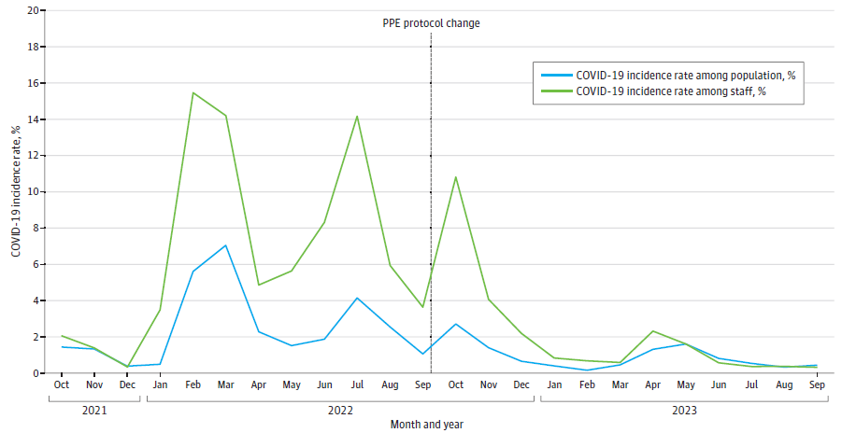
Plastic Waste and COVID-19 Incidence Among Hospital Staff After De-escalation in PPE Use
Retrospective quality improvement study of hospital PPE usage, Tan Tock Seng Hospital, 2000 beds, Singapore
Mean gowns per patient-day (SD) | Pre | Post | Reduction
General wards | 12 (6) | 1 (1) | 11 (7-15)
Intensive care unit | 40 (17) | 19 (5) | 21 (11-31)
Total | 13 (6) | 2 (0.9) | 11 (8-15)
September 2022, → N95 respirators alone for COVID-19 patients care (25%-30% inpatients)
No more gowns/ gloves, eye protection
Monthly incidence of COVID-19 among HCP
Number gowns used/patient-days, before/after PPE de-escalation Total carbon footprint saved, 1 gown = 905 g CO₂e
PPE protocol change
6.6% (5.3)
2.6 > commun.
2.1% (3.0)
1.5 >commun.
12 months study period:
Carbon Footprint: 440532 gowns saved → 398 681 kg CO₂e, 10 kg/PD
Plastic Waste: 0.15 kg of plastic per gown → 66080 kg, 1.6 kg/PD
Cost Savings: USD 0.76 per gown → USD 333970, USD 8.4/PD
Monthnly incidence HCP COVID-19, NS
Stephanie Sutjipto et al, JAMA Network Open. 2025;8(4):e255264. doi:10.1001/jamanetworkopen.2025.5264

Slide 26
Topics addressed
Sequencing and automated surveillance
Candidozyma auris
Clostridioides difficile infections
Catheter line infections and ICU acquired pneumonia
Healthcare associated respiratory infections and PPE
HAI in Nursing homes and Aged care
Healthcare associated Malaria

Slide 27
Air Purifiers and Acute Respiratory Infections in Residential Aged Care
RCT, multicenter (3 RACFs), double blind, 2-period, 2-treatment crossover, 6 months April-Oct 2023, Australia
70 participants room air purifier HEPA-14 filter vs 65 without HEPA-14 filter in their room
Room size similar (50 m³ ), Air purifiers providing 8 air changes/hour
Outcome: incidence of ARIs (at least cough or sore throat or shortness of breath, or coryza)
All participants (n=123)
Completers (n=104)
Missing data:
No reduction in time to first ARI
Variation in the incidence of ARIs
Missing infos: vaccination, mask, diagn
Control
3 months
Intervention
3 months
Control
3 months
Intervention
3 months
44% (29/65)
30% (21/70)
48% (24/50)
30% (16/54)
ARIs
Although statistically non significant results, reduction in absolute number of ARIs with clinical implications (reduction consultations, hospitalisations and severe outcomes)
1 week washout
1 week washout
22% (13/58)
18% (10/55)
24% (13/54)
18% (9/50)
Overall: aOR: 0.6 (0.3-1.0) .07
Completers: 0.5 (0.3-1) .048
Khadar, JAMA Network Open. 2024;7(11):e2443769. doi:10.1001/jamanetworkopen.2024.43769 (

Slide 28
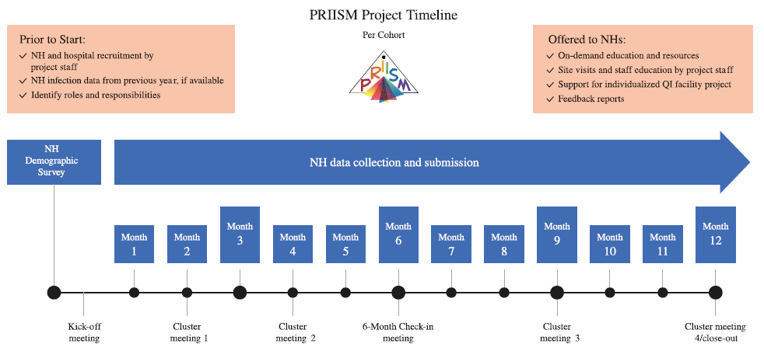
Impact of NH-Hospital Collaboration to Prevent HAI among NH residents
AHRQ, Michigan (PRIISM) project: Collaborative IPC between hospitals & referral NH
to reduce NH-acquired UTIs, CAUTIs, C. difficile, MRSA infections
NHs & local hospital enrolled for 12-month : Cohort 1 & 2: 2018-19 before COVID-19; C3 2020 & C4 2021-22
36-question survey
Project goals, reviewed infection surveillance methods, data reporting, and IPC resources
Assess improvements and identify opportunities
Jones et al Clinical Infectious Diseases, 29 April 2025, https://doi.org/10.1093/cid/ciaf122

Slide 29
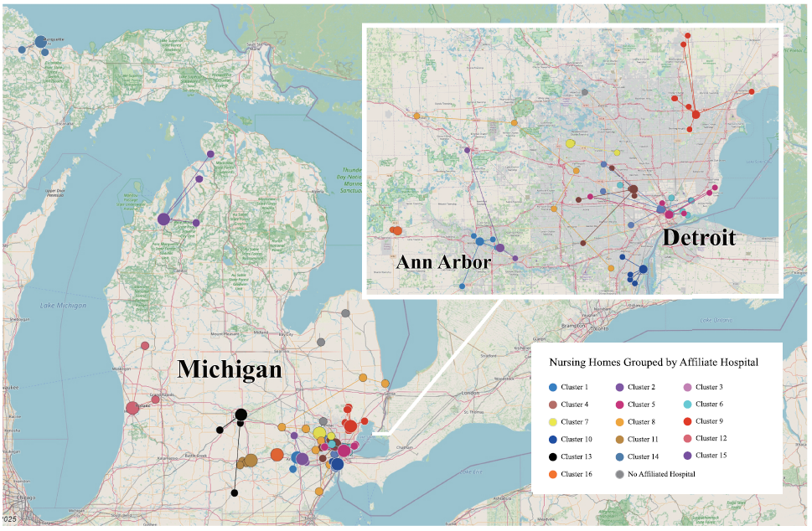
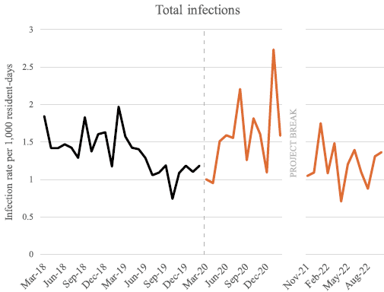
Impact of NH-Hospital Collaboration to Prevent HAI among NH residents
92 community-based NHs recruited across 4 cohorts,
Final analytic sample included 63 NHs
Adjusted incidence reduction | Pre-COVID-19 | COVID-19 period
Total infections | -32%, 0,03 | +19%, NS
UTI | -29%, NS | +37%, NS
CAUTI | -7%, NS | -52%, NS
CDI | -48%, NS | +152%, NS
MRSA | -64%, NS | -19%, NS
COVID-19
Collaborative frameworks focusing on shared goals can be successful. Still the case after COVID-19?
Jones et al Clinical Infectious Diseases, 29 April 2025, https://doi.org/10.1093/cid/ciaf122

Slide 30
Topics addressed
Sequencing and automated surveillance
Candidozyma auris
Clostridioides difficile infections
Catheter line infections and ICU acquired pneumonia
Healthcare associated respiratory infections and PPE
HAI in Nursing homes and LTCFs
Healthcare associated Malaria

Slide 31
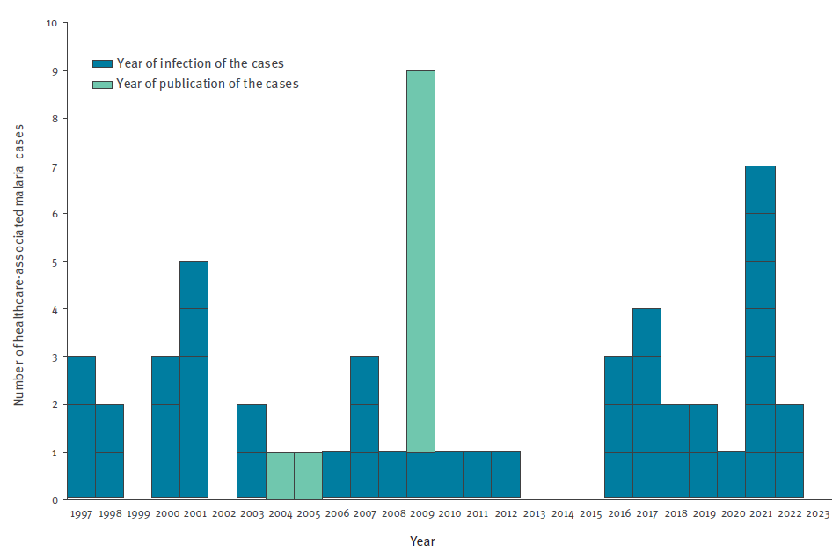
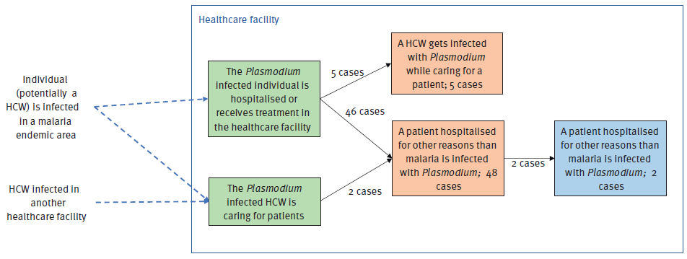
Healthcare-associated Malaria
Systematic review 37 studies to explore determinants of 55 HA-malaria cases, 64% in Europe
Number of healthcare-associated malaria cases per year of infection (n = 45), 1997–2023
Transmission pathways
Secondary cases
Primary cases
Individual (HCW, Pts) infected in endemic area
Tertiary cases
HCW infected in other HCF
n = 55 | Patient | HCW
Flushing vascular catheter with conta. solution | 13 | 0
Manipulation of intravenous catheter | 6 | 2
Via contaminated gloves | 2 | 0
Capillary blood glucose measurement | 3 | 1
Median incubation: 15 days (10–20)
11 hyper-parasitaemia, 6 recovered, 1 died
Absence of vectors or climate conditions (e.g. winter)
Too short time between I case and II case
Gossner Céline Euro Surveill. 2025;30(11):pii=2400393. https://doi.org/10.2807/1560-7917.ES.2025.30.11.2400393

Slide 32





Thank you
Follow EUCIC on Bluesky : @eucic.bsky.social

Slide 33
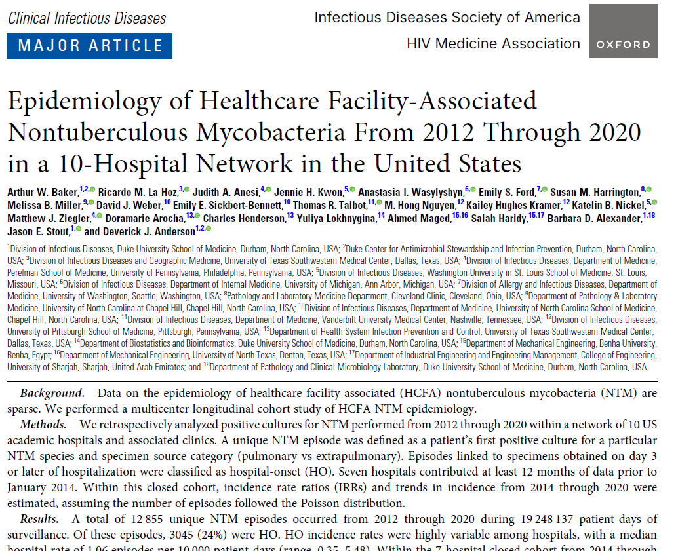

Slide 34
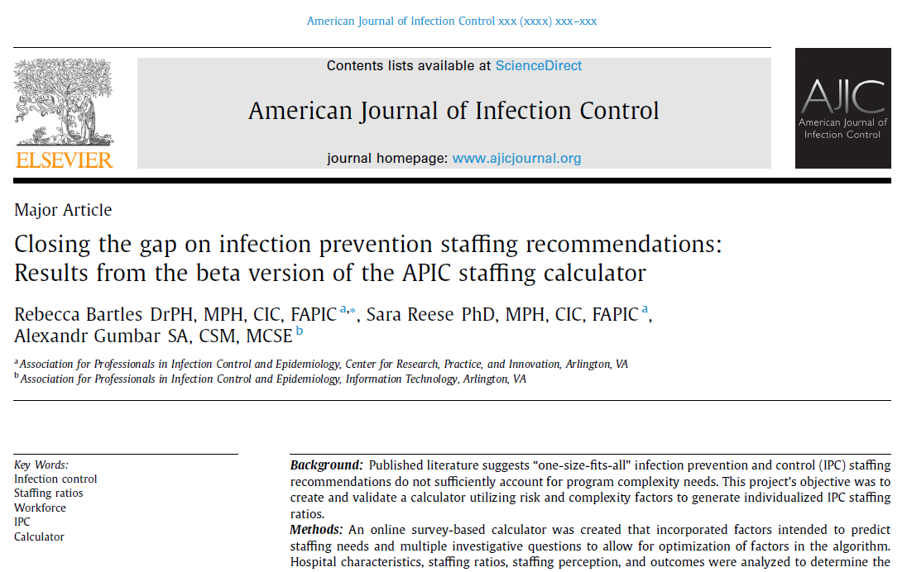

Slide 35
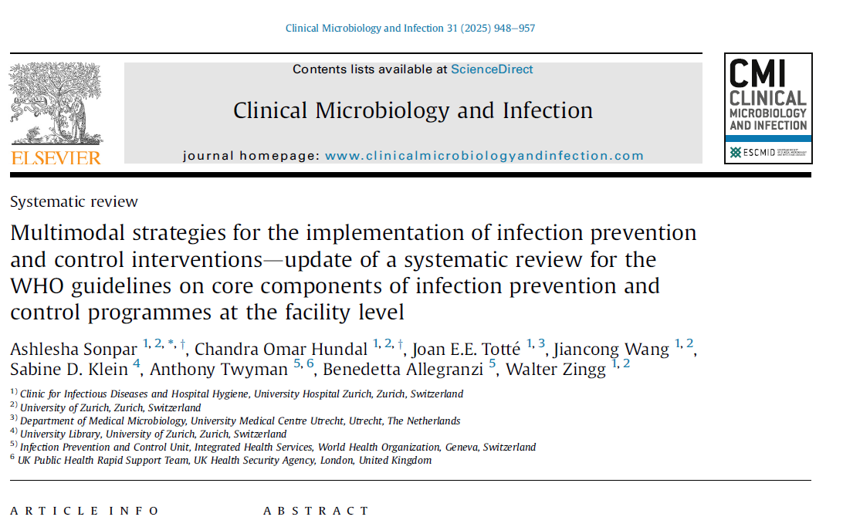

Slide 36
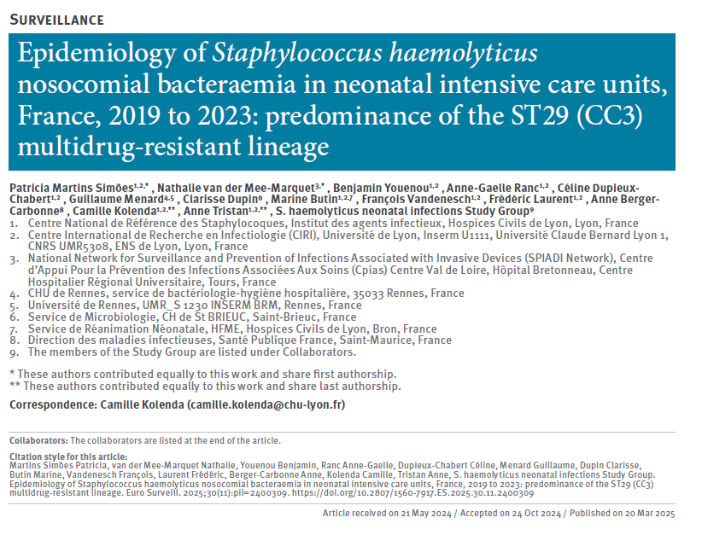

Slide 37
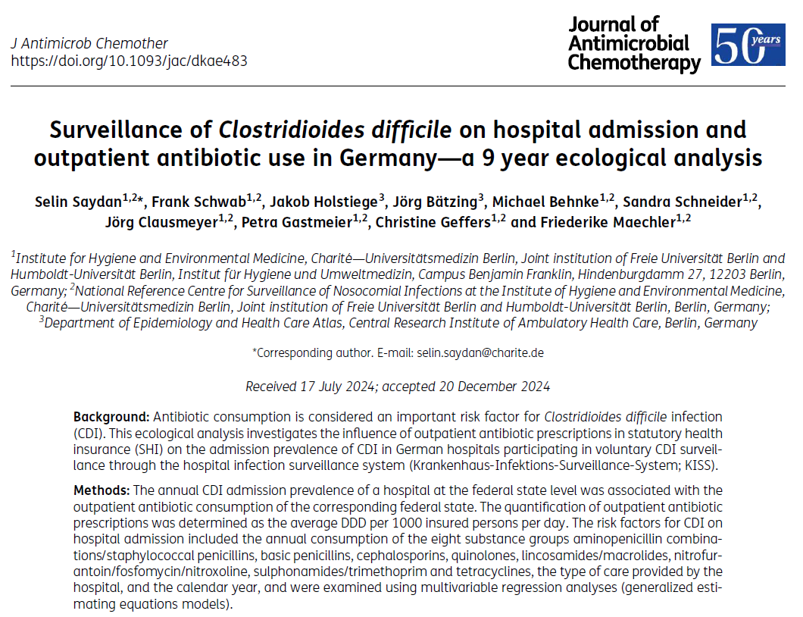

Slide 38
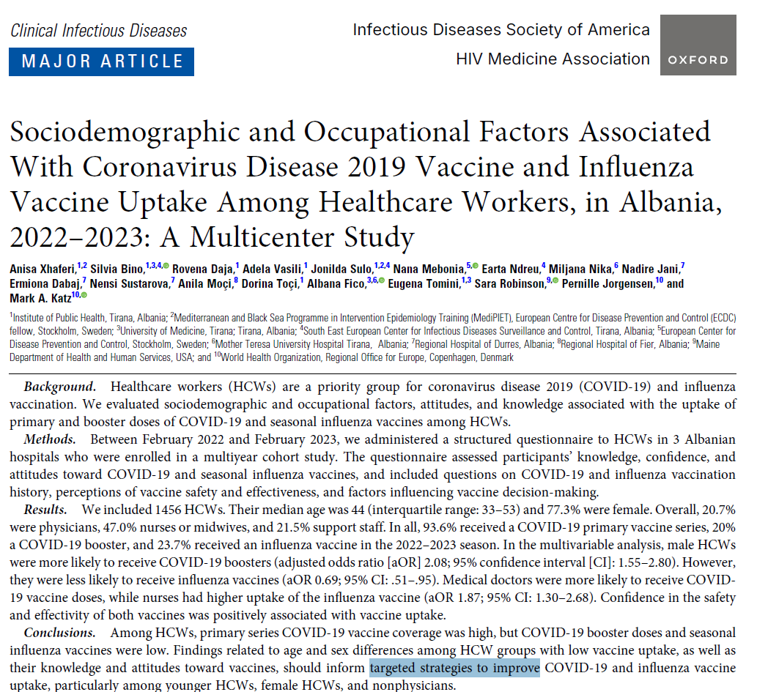

Slide 39
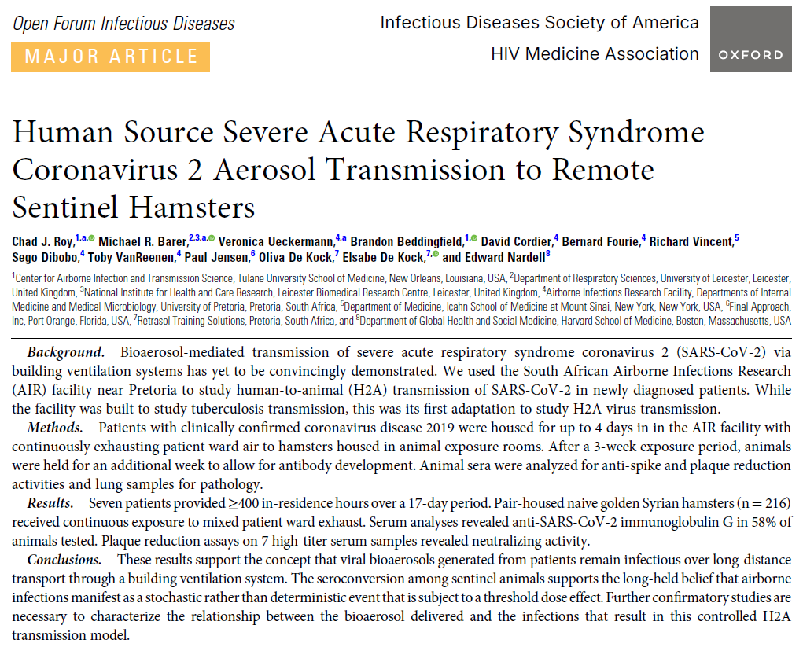

Slide 40
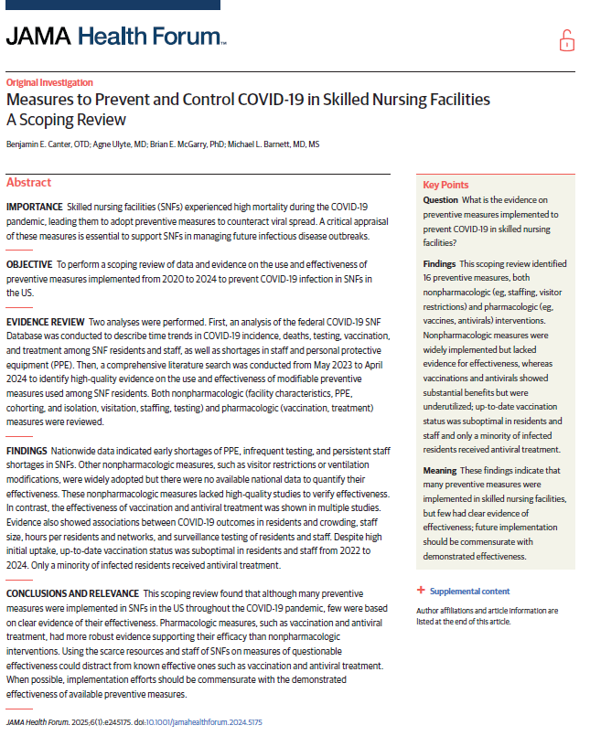

Slide 41
Thank you
Follow EUCIC on Bluesky : @eucic.bsky.social
X
@EUCIC1

