Slide 1


Prevention of
Surgical Site Infections
Gabriel BIRGAND
EUCIC Clinical Coordinator

Slide 2

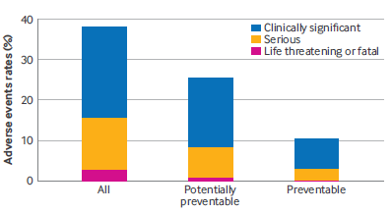
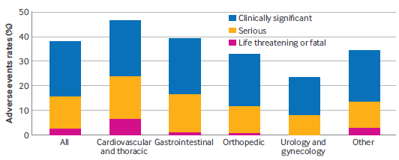
Safety of inpatient care in surgical settings: cohort study
Objective: To estimate the frequency, severity, preventability of adverse events associated with perioperative care
Multicenter retrospective cohort study, 11 US hospitals, 1009 patients randomly selected among 64 121 surgical admissions during 2018, 9 nurses, 8 physicians
Adverse events: n=592 38% (33-43), older patients in CVTS
59% potentially preventable
21% probably preventable
Major adverse events: 16% (13-19)
49% related to surgical procedures
27% adverse drug events
12% healthcare associated infections
Adverse events identified in >1/3 patients admitted to hospital for surgery
Nearly 50% as major and most potentially preventable
Antoine Duclos | BMJ 2024;387:e080480 | doi: 10.1136/bmj-2024-080480

Slide 3

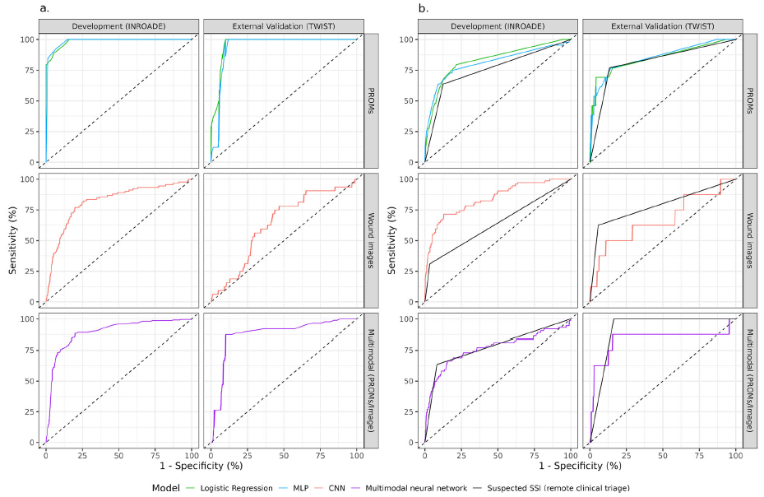
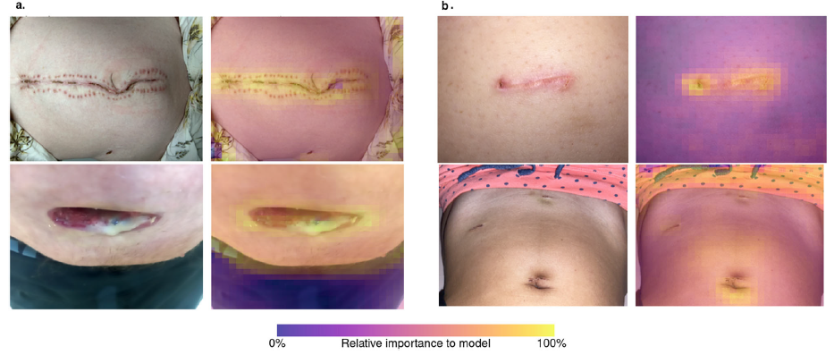
Multimodal machine learning to predict surgical site infection with healthcare workload impact assessment
Adult gastrointestinal surgery patients collected wound images and patient-reported outcome measures (PROMs) for 30-days postoperatively
Neural networks for PROMs & images combined to predict SSI diagnosis within 48 h.
Diagnostic accuracy of different approaches
Class activation heatmaps
Simulated usage indicated an 80% reduction in staff
time (51.5 to 9.1 h) without compromising diagnostic accuracy
Kenneth A. McLean, npj Digital Medicine | ( 2025) 8:121 https://doi.org/10.1038/s41746-024-01419-8

Slide 4

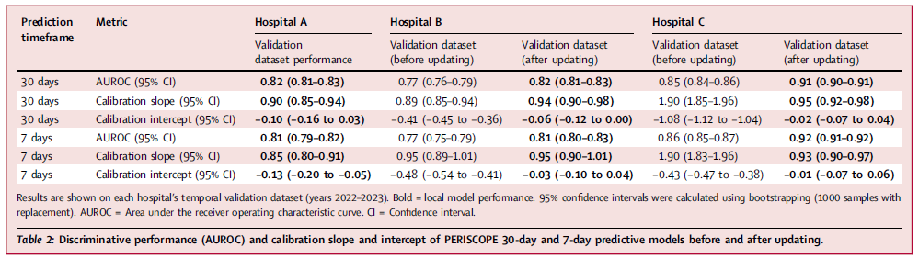
Development and validation of artificial intelligence models for early detection of postoperative infections (PERISCOPE)
XGBoost models to predict postoperative infections within 7 & 30 days of surgery
Retrospective pre-operative & intra-operative EHR data 2014 to 2023, various surgical spe, Hospital A & validated & updated at Hospitals B & C, Netherlands & Belgium
AI system PERISCOPE®, prediction issued within 1 h after procedure, to be used by physicians/nurses
Labelled positive 7-day & 30-day
1) infectious complication registered
2) Antibiotics administered > 72 h, excluding prophylactic regimes and/or
3) surgical intervention
performed to treat an infection for the relevant time frame
253,010 surgical procedures, 23,903 infections within 30-days
1st study aimed at predicting all types of postoperative infections (including SSIs, pneumoniae, urinary tract infections, and others), using local hospital data for validation that does not require manual data inputs.
After external model validation, updating was performed on local historical datasets.
Siri L. van der Meijden The Lancet Regional Health – Europe 2025;49: 101163

Slide 5

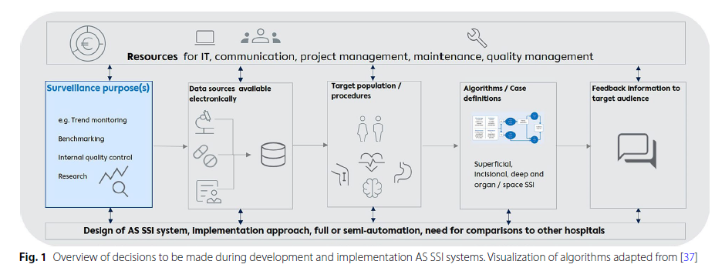
Automated surveillance for SSI in hospitals and surveillance networks–expert perspectives for implementation
Full automation, information available electronically, accessible in central database or register
Simple algorithm, avoid large variability in source data between hospitals, creation of a rule-based algorithm applied to data from all hospitals
3. Ascertaining performance of algorithm & completeness of data sources
4. Exclusion of superficial SSIs from the case-definition.
5. Non-inclusion of information on the pre- or postoperation use of medication, prophylaxis, or the use of antimicrobial prescriptions to treat the SSI unless national data can be linked to HAIBA.
6. HAIBA’s trend monitoring for SSIs may underestimate of the number of SSIs → identification of SSI cases based on microbiological culture results
Denkel et al. Antimicrobial Resistance & Infection Control (2024) 13:155, https://doi.org/10.1186/s13756-024-01505-2

Slide 6

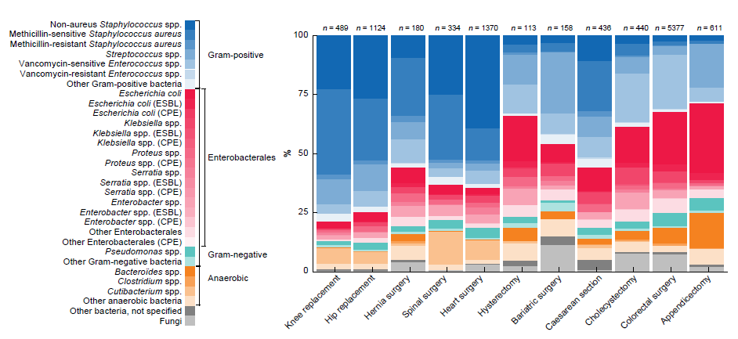
Influence of patient characteristics on microbial composition in surgical-site infections: insights from national surveillance study
Retrospective cohort study included 538 893 patients from Swiss noso
Multilabel classification methods, adaptive boosting and Gaussian Naive Bayes
10 632 microbiological wound swabs available.
57% Enterobacterales, 31% Staphylococcus spp. 28% Enterococcus spp
Predictors of the microbial composition of SSIs
Age (mean feature importance 0.260, 95% c.i. 0.209-0.309)
BMI (0.224, 0.177-0.271),
Duration of surgery (0.221, 0.180-0.269)
Increasing age and duration of surgical procedure as well as decreasing BMI were associated with a shift from Staphylococcus spp. to Enterobacterales and Enterococcus spp.
InSSIght tool enhances the understanding of these predictions with ICE plots → graph how changes in age, BMI, and duration of surgery affect the likelihood of different microbes being present.
Sarah Peisl BJS, 2024, znae138 https://doi.org/10.1093/bjs/znae138
https://colab. research.google.com/drive/1R1v-EYn0bH5DLN0UniFiE6kHUUIHX1 ok?usp=sharing.

Slide 7

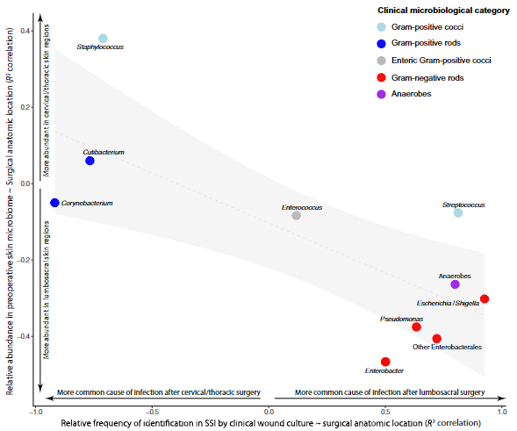
Contribution of the patient microbiome to SSI and antibiotic prophylaxis failure in spine surgery
Prospective cohort study
204 patients undergoing instrumented spine surgery, 14 (6.8%) SSI
Preoperative microbiome sampling
Skin, nasal, and rectal swabs for metagenomic analysis
Perioperative antibiotic prophylaxis (cefazolin)
Genomic comparisons
Each patient’s SSI isolate vs their own preoperative microbiome and vs other patients’ microbiome data to rule out common sources
Correlation between preoperative skin microbiome composition and postoperative SSI pathogens as a function of surgical anatomic location
• Most SSI bugs came from the patient: ~86%
• Antibiotic prophylaxis mismatch: ~59%
• Time for a paradigm shift in SSI prevention?
• Should we consider individualised surgical prophylaxis?
Long et al., Sci. Transl. Med. 16, eadk8222 (2024) 10 April 2024

Slide 8

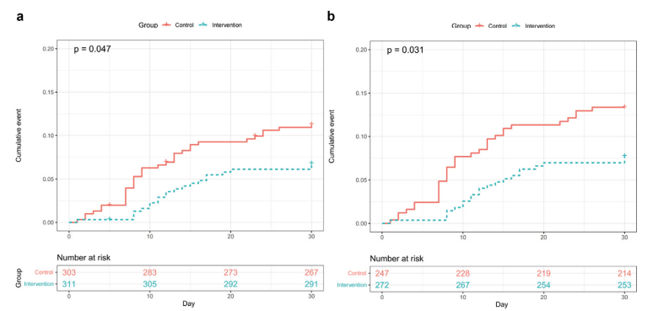
Bathing with 2% chlorhexidine gluconate vs routine care for preventing SSI after pancreatic surgery
RCT, large-volume pancreatic centre, 1/01/2021 to 31/12/2022
614 patients in intention-to-treat analysis
311 intervention: bathing with a 2% CHG wipe / 303 control: routine care, soap & water
 | Intervention | Control | p
Int to treat | 21/311, 6.8% | 33/303, 10.9% | 0.07
Perprotocol | 21/272, 7.7% | 33/242, 13.4% | 0.036
ITT analysis
PP analysis
Control
Intervention
Time to SSI significantly extended in the intervention arm (log-rank test, p 0.047)
No adverse events
Bathing with 2% CHG could potentially reduce the incidence of SSI for the patients scheduled to undergo pancreatic surgery
Wen-Sen Chen, Clinical Microbiology and Infection, https://doi.org/10.1016/j.cmi.2025.01.004

Slide 9

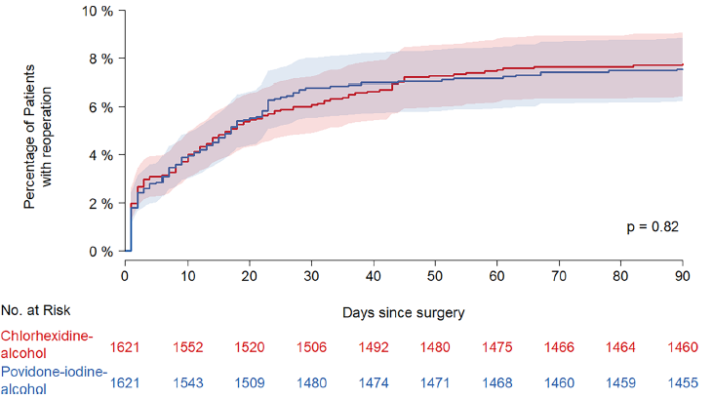
Chlorhexidine‑alcohol compared with povidone‑iodine‑alcohol skin antisepsis protocols in major cardiac surgery
Multicenter, open-label, randomized, two-arm, assessor-blind, superiority trial conducted in 8 French hospitals
Major heart/aortic surgery via sternotomy, with/without saphenous vein or radial artery harvesting
2% chlorhexidine-alcohol or5% povidone-iodine-alcohol
 | CHG-OH N=1621 | PVI-OH N=1621 | Risk diff.
Median age | 69 | 69 | -
Men | 1276 (78%) | 1247 (77%) | -
Reop. 90 days | 7.7% (n=125) | 7.5% (n=121) | 0.25 [1.6–2.1] P = 0.8
SSI | 4% (n=65) | 3.3% (n=53) | 0.74 [0.5–2] P = 0.26
PVI-OH
CHG-OH
Similar length of hospital stay, intensive care unit or hospital readmission, mortality and surgical site adverse events
Surgical site using chlorhexidine-alcohol was not superior to povidone-iodine-alcohol for reducing reoperation and SSI rates
Matthieu Boisson Intensive Care Med
https://doi.org/10.1007/s00134-024-07693-0

Slide 10
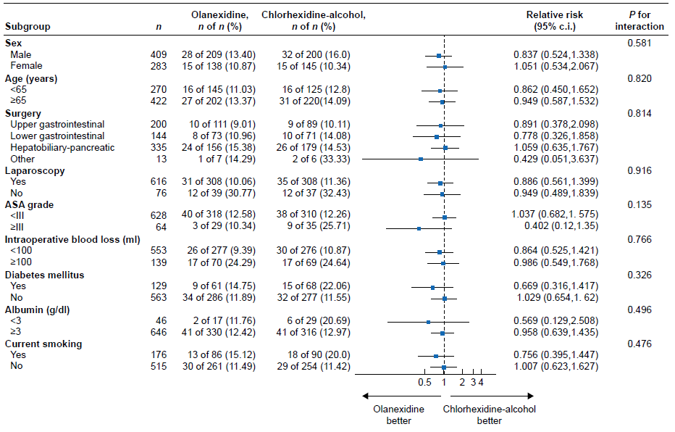
Efficacy of aqueous olanexidine compared with OH-based chlorhexidine for surgical skin antisepsis on the incidence of SSI in clean-contaminated surgery
700 patients from five institutions underwent randomization
 | Olanexidine N=347 | CHG-alcohol N=345 | Adj. risk diff
30-day SSI | 12.4% (n=43) | 13.6% (n=47) | −0.012
Sup SSI | 17 (4.9) | 19 (5.51) | −0.006
aRR: 0.911 (0.625 to 1.327); P = 0.626
Positive wound bacterial test in 49 patients with olanexidine vs 41 patients in CHG-OH
Enterococcus spp. (12 of 49 (24.5%) in olanexidine group and 12 of 41 (29.3%) in chlorhexidine-alcohol group).
Olanexidine was not superior to chlorhexidine-alcohol in reducing SSI rates, but it had comparable efficacy, supporting its use as an alternative antiseptic in clean-contaminated surgeries, particularly in the context of contraindicated alcohol-based solutions
Masashi Takeuchi BJS, 2025, znaf065 https://doi.org/10.1093/bjs/znaf065

Slide 11
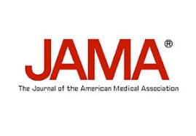
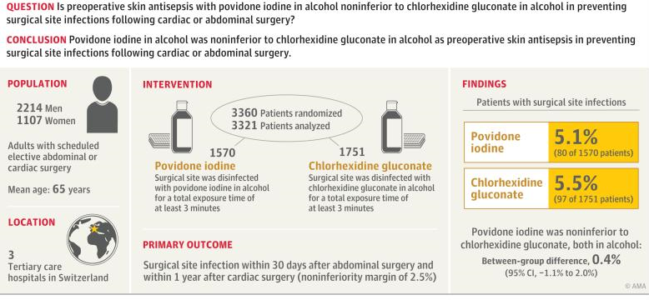
Povidone Iodine vs Chlorhexidine Gluconate in Alcohol for Preoperative Skin Antisepsis
Andreas F. Widmer JAMA. doi:10.1001/jama.2024.8531 Published online June 17, 2024.

Slide 12
ESCMID/EUCIC clinical guidelines on pre-operative decolonization and targeted prophylaxis in patients colonized by MDR Gram-positive bacteria before surgery
Questions | Recommendation | Strength of recommendation | Level of evidence
Should patients be screened for S. aureus prior to surgery? | Yes for MSSA/MRSA before elective cardiac and orthopaedic surgery, according to epi | Ungraded good practice statement | Indirect evidence,
Should S. aureus carriers be decolonized prior to surgery? | Yes for MSSA/MRSA before elective cardiac and orthopaedic surgery, according to epi | Strong | Moderate
 | before other surgeries | Conditional | Low
Should SAP be adapted in S. aureus carriers before surgery? | We suggest perioperative targeted MRSA carriers before cardiac, orthopaedic surgery, and neurosurgery | Conditional | Low
 | insufficient evidence for other surgery | No recommendation
Should S. aureus carriers receive combined interventions prior to surgery? | We suggest combined interventions (decolonization and targeted prophylaxis) for MRSA before cardiac and orthopaedic surgery. | Conditional | Very low
 | other surgeries | No recommendation
No recommendation for VRE and Pan-drug-resistant (PDR)-Gram-positive bacteria
Elda Righi Clinical Microbiology and Infection xxx (xxxx) xxx

Slide 13
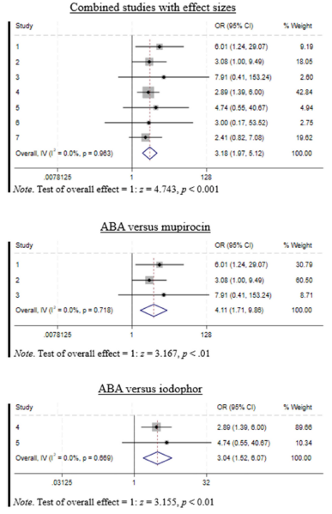
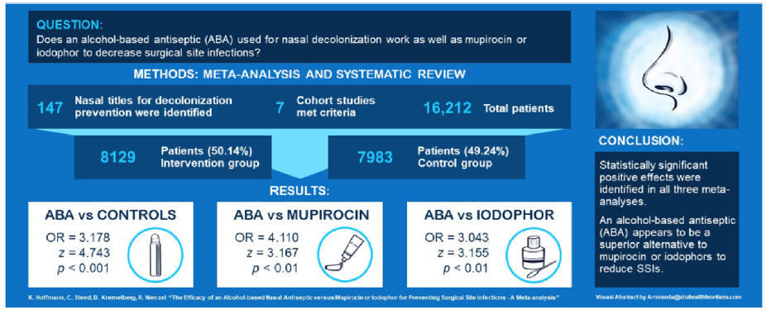
The efficacy of an alcohol-based nasal antiseptic vs mupirocin or iodophor for preventing surgical site infections: A meta-analysis
Limitation: Type of surgery?
Karen K. Hoffmann American Journal of Infection Control 52 (2024) 1202–1208

Slide 14
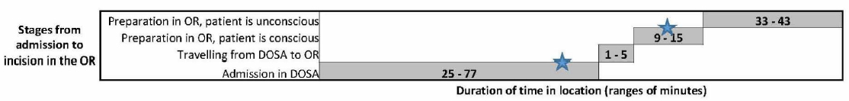
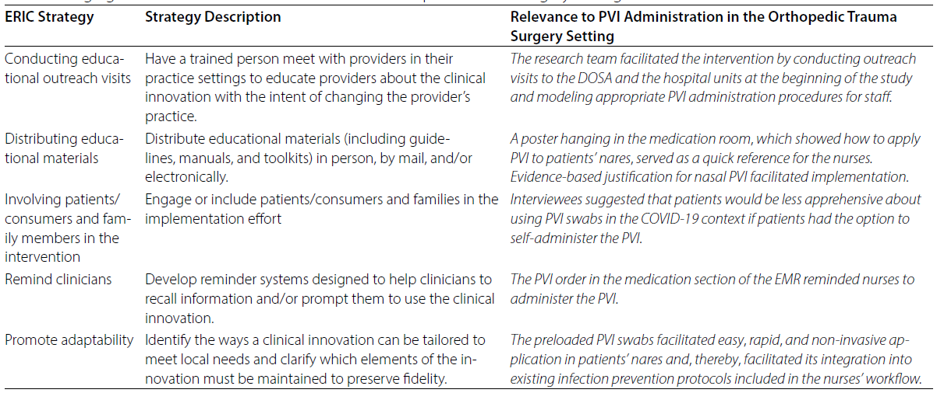
Implementing intranasal povidone-iodine in the orthopedic trauma surgery setting to prevent SSI: a qualitative study
Small phase IV post-marketing study from 2020 to 2021
Human factors task analysis to determine the optimal time and hospital location to perform PVI decolonization for patients receiving these orthopedic fixation procedures.
Blue stars = possible points in the process when patients are conscious & PVI could be administered
Visual aids facilitated PVI administration
Low staff and patient burden facilitated PVI implementation into existing workflow
Having patients self-administer PVI facilitate staff workflow
Emphasizing PVI efficacy to staff and patients incentivized adoption
Including nasal PVI with medications in EMR facilitated implementation for some staff roles
Racila et al. Antimicrobial Resistance & Infection Control (2025) 14:14; https://doi.org/10.1186/s13756-025-01526-5

Slide 15
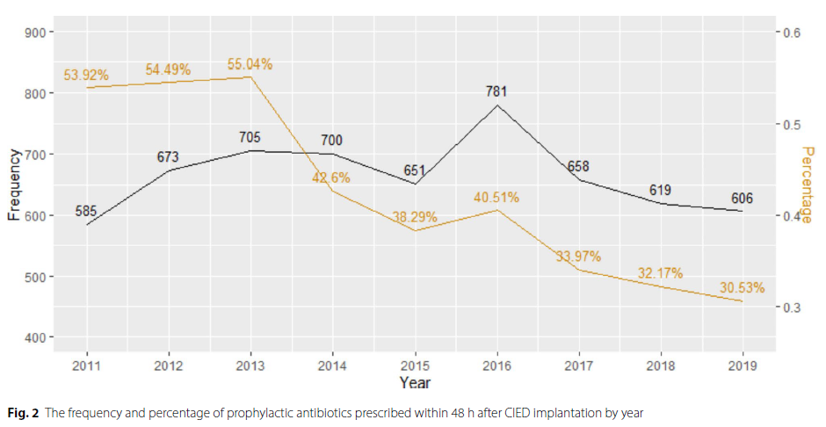
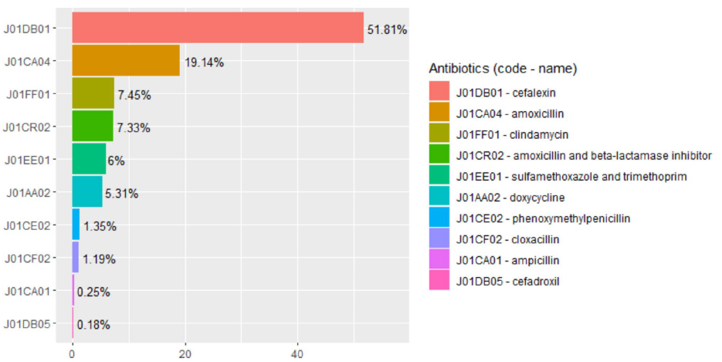
Rates of post procedural prophylactic antibiotic use following cardiac implantable electronic device insertion and the impact on SSI in Alberta, Canada
Population-based cohort study in Alberta. Administrative data, all patients ≥ 18 who underwent outpatient CIED implantation, Jan 2011 to Dec 2019 to antibiotics used for SAP within 48 h of implantation
14,718 CIED implantations, 5,978 (41%) with prophylactic antibiotic prescription
0.8% (n = 46) developed a complex SSI at 1 year
 | SAP | No SAP | p
1 year mortality | 2.0% (n = 122) | 3.4% (n = 293) | < 0.05
RR of infection | 0.74, 0.46–1.17 | 0.8, 0.63–1.02 | -
Rennert-May et al. Antimicrobial Resistance & Infection Control (2024) 13:147

Slide 16

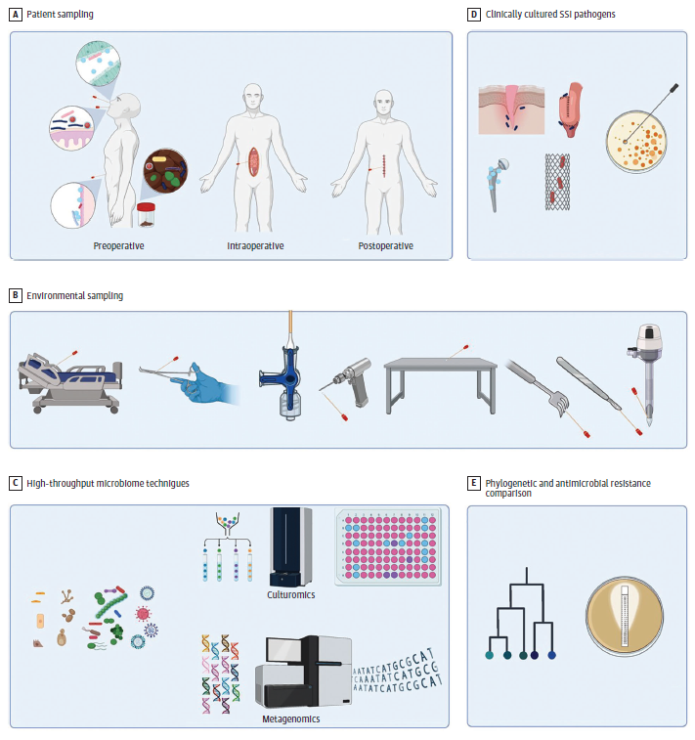
Preventing Surgical Site Infections in the Era of Escalating Antibiotic Resistance and Antibiotic Stewardship
Application of Next-Generation Technologies to Understand the Pathogenesis and Antimicrobial Resistance Patterns of SSIs
Avoid Antibiotics in Contexts Where Studies Indicate They Are Not Beneficial
Consider Antimicrobial Strategies With Lower-Risk Profiles
Combined Oral Antibiotic and Mechanical Bowel Preparation
Preoperative Decolonization
Targeting Bacterial Virulence Rather Than Viability
Use of Local Antimicrobial Application to the Skin
Maximize the Effect of SAP Through More Targeted Use
Leverage Nonantibiotic SSI Prevention Measures
Temperature and Glucose Management
Closed Incision Negative Pressure Wound Therapy
Oral Hygiene
Dietary Prehabilitation and Probiotics
Enhanced Recovery Programs
Consider New Models of SSI Pathogenesis
Dustin R. Long JAMA Surgery Published online June 26, 2024

Slide 17
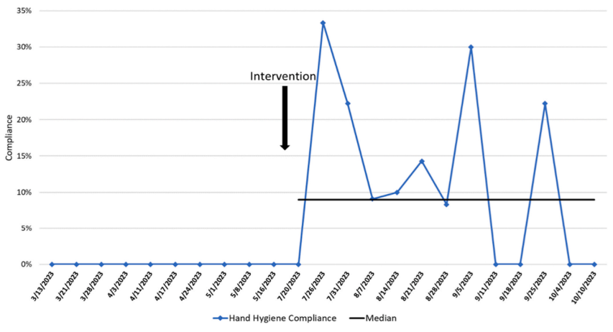
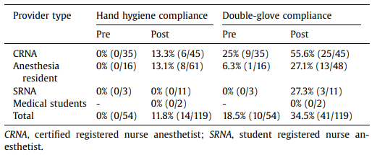
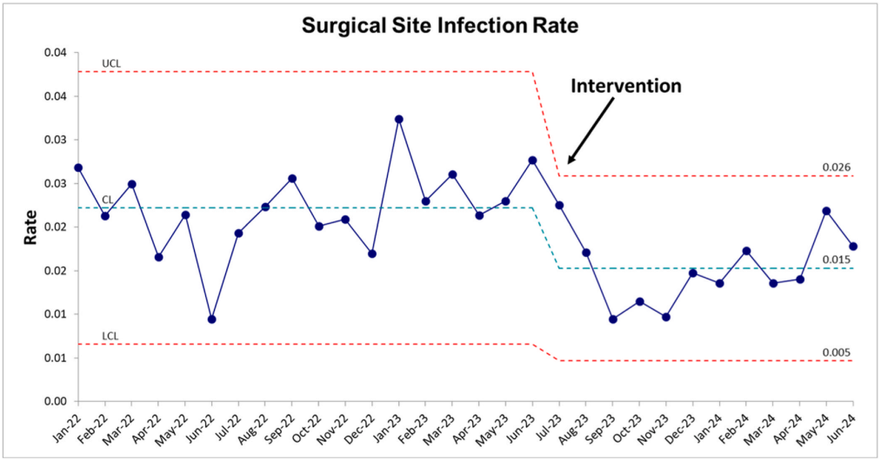
Clean Hands are Caring Hands: Improving Anesthesia Provider Hand Hygiene and Double Glove Compliance During Induction of General Anesthesia
Pre/post-implementation quality improvement design was used with Plan-Do-Study-Act cycles
Hand hygiene compliance of anesthesia providers during induction of general anesthesia with endotracheal tube.
Intravenous (IV) pole-mounted automatic hand sanitizer dispenser
Education on hand hygiene and double-gloving practices
evidence-based implementation strategies, printed educational materials, video, in-person and virtual education meetings
Small visual reminders that stated “REMEMBER: Sanitize hands & double glove before induction! ☺” were placed within the anesthesia workstation
Allie-Lane F. Regier AJIC https://doi.org/10.1016/j.ajic.2024.09.010

Slide 18
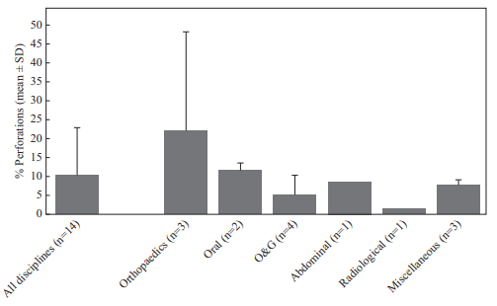
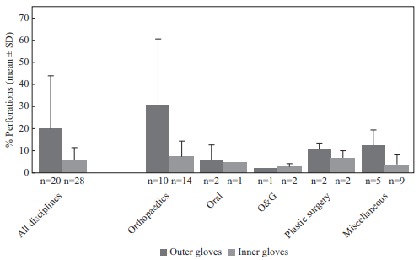
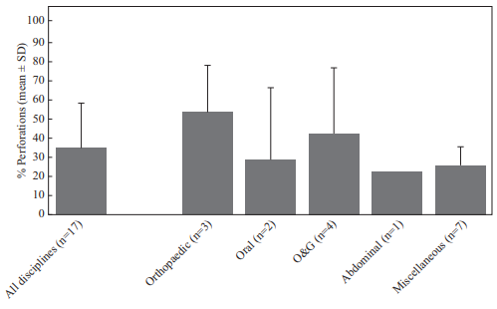
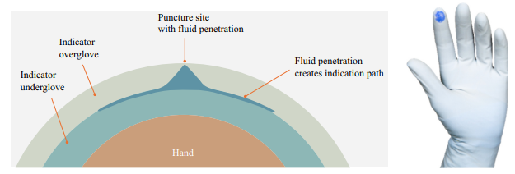
Glove Breach Occurrence During Surgical Procedures: The Benefits of Double/Indicator System Gloves
Objective: scoping review to assess the rate of surgical glove breaches, whether these pose an increased risk of infection
Mean glove breach rate across surgical disciplines
Mean percentage of outer and inner glove breach rates in double gloving studies
103 articles
Mean incidence of glove breaches: 10.3%; 22.2% in orthopaedic
>50% orthopaedic proc. (53%) reported perforation
>70% of glove breaches go undetected
Studies showing a 2-fold increased risk of SSI when breach in surgical gloves
Mean percentage of procedures where a glove perforation occurred.
Indicator system glove.
Double gloving with an indicator system ↘ the risks, as the detection of a glove breach will ↗ from 34% to 83% using a coloured breach-indicator system.
M.G. Rippon Journal of Hospital Infection 161 (2025) 92e113

Slide 19
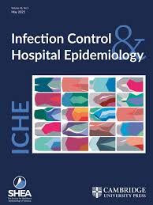
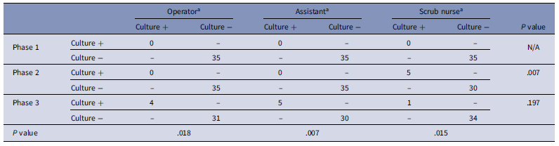
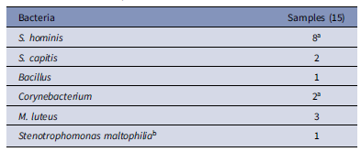
Bacterial contamination of surgical gloves during clean orthopedic surgery
Objective: examined surgical gloves for bacterial contamination 3 times during each of 35 surgeries performed by a single surgeon for closed fractures or noninfectious arthropathies in orthopedics
Contamination identified on the gloves at the end of the surgery:
4 (11.4%) Surgeon
5 (14.3%) First assistant
Bacteria detected 4.7%, 15/315 samples
Surgeons and assistants should change gloves periodically, and scrub nurses should be careful when opening packages and handing over implants
Jee Young Lee Infection Control & Hospital Epidemiology (2024), 45, 991–993 doi:10.1017/ice.2024.49

Slide 20
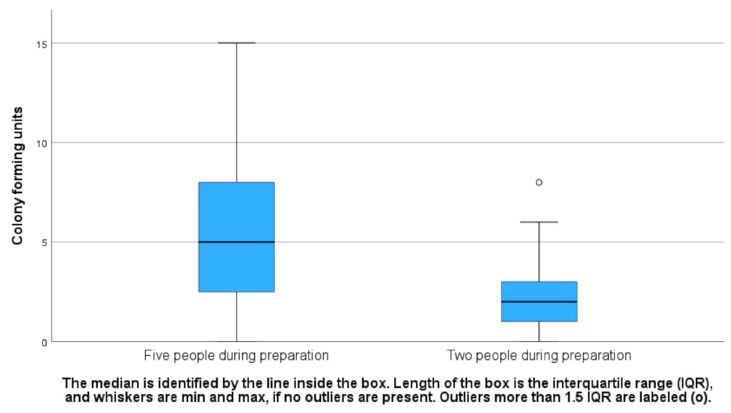
The effect of five versus two personnel on bacterial air contamination during preparation of sterile surgical goods in the operating room
RCT used an intervention group in which two individuals prepared the surgical goods and a control group in which five individuals prepared the goods
70 surgeries, open-heart surgeries, mainly CABG (n = 31) & aortic valve replacement (n = 11)
Mean time to prepare the sterile surgical goods: 32 min (SD: 9.3)
5 pers
101/210 (48%)
2 pers
73/204 (36%)
207 blood agar, 207 FAA plates for bacterial air conta:
30% Cutibacterium acnes
13% S. epidermidis, 13% Micrococcus luteus
7% S. hominis, 7% S. capitis
2 SSI | SSI | Air prep
5 pers | S. aureus, S. lugdunensis | C. acnes 4 CFU, M. luteus 2 CFU, S. warneri 1 CFU
2 pers | C. acnes, Corynebacterium kroppenstedtii, S. epi | C. acnes 1 CFU, S. epi 2 CFU
Importance of limiting the number of personnel in
the OR to minimise general bacterial contamination
Camilla Wistrand et al. Antimicrobial Resistance & Infection Control (2025) 14:68 https://doi.org/10.1186/s13756-025-01589-4

Slide 21

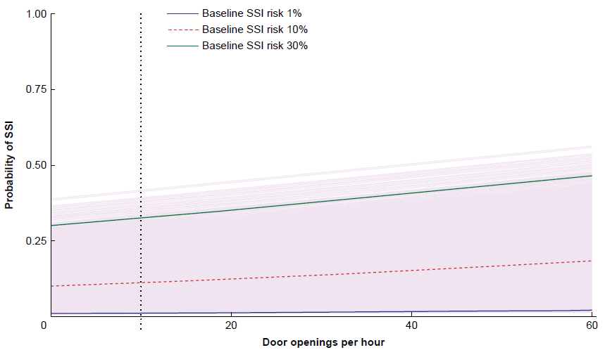
Effect of the number of door openings in the operating room on SSI: individual-patient data meta-analysis
8 observational studies, 4412 patients, 6.0% incidence of SSI
Each extra door opening per hour ↗ risk of SSI : aOR 1.012, 1.005-1.019; τ2 = 0.095
Baseline infection risk = 2%, 35 additional DO/h per surgery needed to cause 1 additional SSI/100 pts
3.5% SSI in clean surgeries vs 8.0% in non-clean operations
Association between DO/h & SSI did not differ between
non-clean and clean surgeries
implant and non-implant
high- and low-income countries
Effect of door openings on the rate of SSI from a one-step meta-analysis of individual-patient data using a random-effects framework, and corrected for confounders
The certainty of the available evidence is too low and the relative effect on clinical outcomes too small to support a rigorous zero door-openings policy to reduce SSI rates
Hannah Groenen BJS Open, 2025, zraf044 https://doi.org/10.1093/bjsopen/zraf044

Slide 22

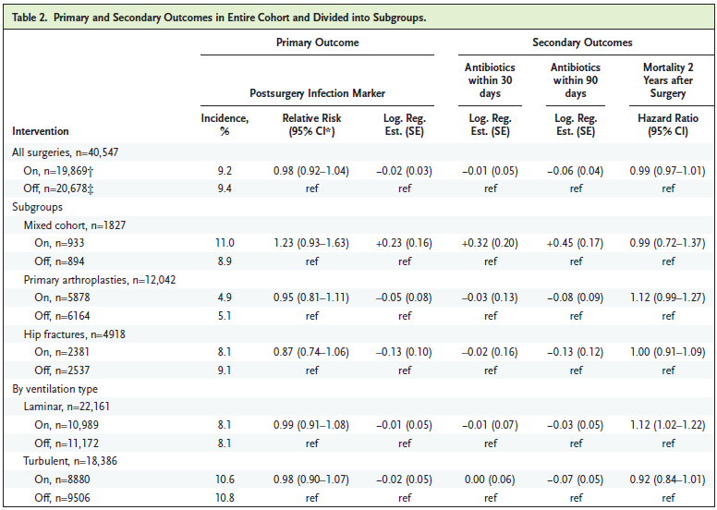
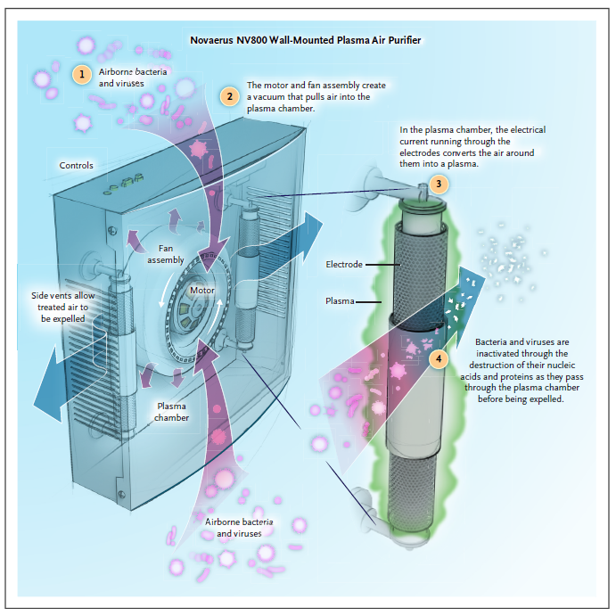
Effect of Plasma Air Purifiers on Infection Rates in Orthopedic Surgery
Trial investigated the effectiveness of a low-cost air purifier in reducing SSI rates after orthopedic surgery, 2017-2021
Nationwide, 7 hospitals in Sweden, double-blind, cluster-randomized crossover, placebo-controlled superiority
40,547 patients
Novaerus NV800 air purifiers on vs off
PSIM = proxy for SSI within 12 weeks postoperatively:
1. Documented use of ATB 2 days or more after surgery targeting S. aureus
2. ICD code indicating postoperative infection at the date of readmission
3. NOMESCO code indicating reoperation due to infection
No effect addition of plasma-based air purifiers to modern OR with standard ventilation systems on PSIM rates following orthopedic surgery.
Anders Persson March 25, 2025 NEJM Evid 2025;4(4)
Anders Persson Published March 25, 2025 NEJM Evid 2025;4(4) DOI: 10.1056/EVIDoa2400289

Slide 23

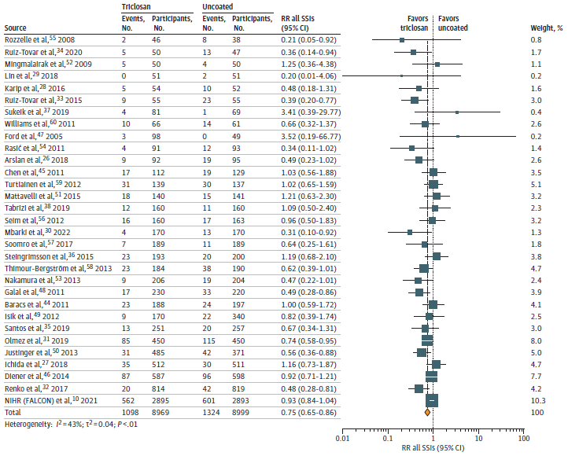
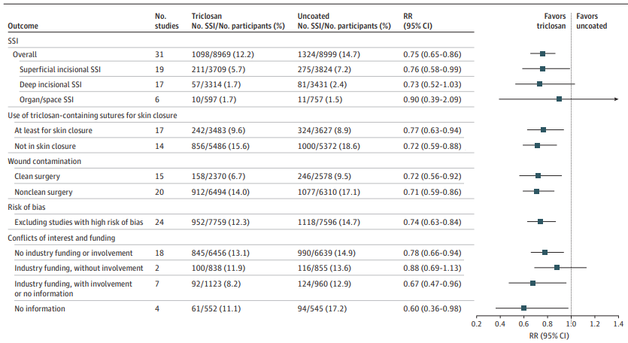
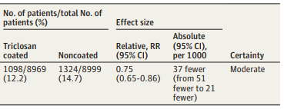
Triclosan-Containing Sutures for the Prevention of Surgical Site Infection
Syst. review & meta-analysis of association of triclosan-containing sutures with SSI
31 studies (15 additional RCTs), 17 968 participants
Moderate certainty triclosan-containing sutures associated with reduced risk of SSI / sutures without triclosan
Hasti Jalalzadeh JAMA Network Open. 2025;8(3):e250306. doi:10.1001/jamanetworkopen.2025.0306

Slide 24

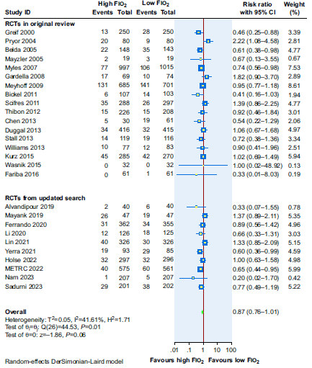
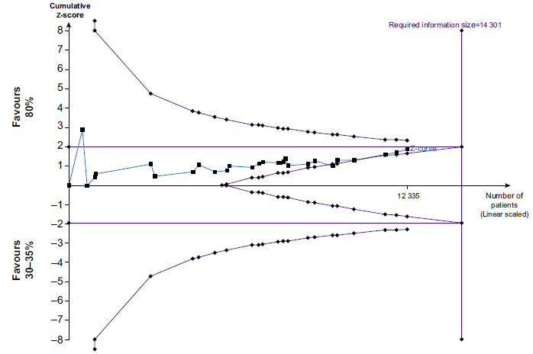
Perioperative oxygen therapy: an overview of systematic reviews and meta-analyses
Perioperative oxygen routinely used
Evidence of its clinical impact remains inconsistent
Administering 80% oxygen perioperatively
Minimal effect on reducing SSI and can increase the risk of atelectasis
Postoperative noninvasive ventilation and high-flow nasal O₂
Potential reductions in pulmonary complications, data quality is low.
59 systematic reviews in this overview
High FIO2 (80%) unlikely beneficial or a harmful effect on SSI & mortality
Postoperative noninvasive ventilation little or no effect on mortality compared with conventional oxygen therapy.
No evidence on beneficial effect on various respiratory outcomes for postoperative high-flow nasal oxygen vs conventional oxygen therapy.
Trial sequential analysis of SSI in all trials included in the meta-analysis.
Adel Elfeky British Journal of Anaesthesia

Slide 25
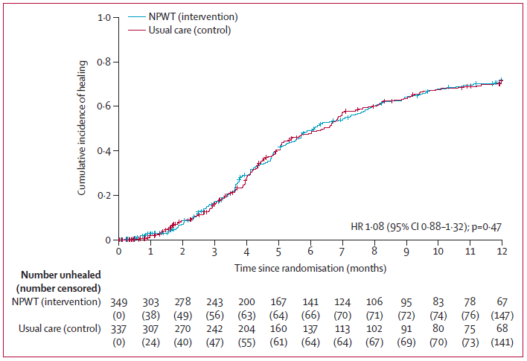
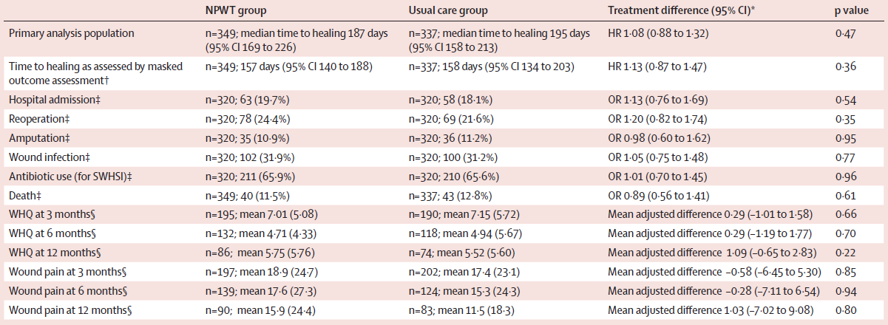
Negative pressure wound therapy versus usual care in patients with surgical wound healing by secondary intention in the UK (SWHSI-2)
Open-label, multicentre, parallelgroup, RCT in 29 UK NHS Trusts
May 2019 to Jan 2023, 686 participants with an SWHSI were randomly assigned to receive NPWT (n=349) or usual care (n=337).
No evidence that NPWT reduced the time to wound healing compared with standard dressings in a population of patients with predominantly lower limb wounds, including those with complications of diabetes.
Catherine Arundel Lancet 2024; 405: 1689–99

Slide 26
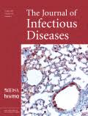
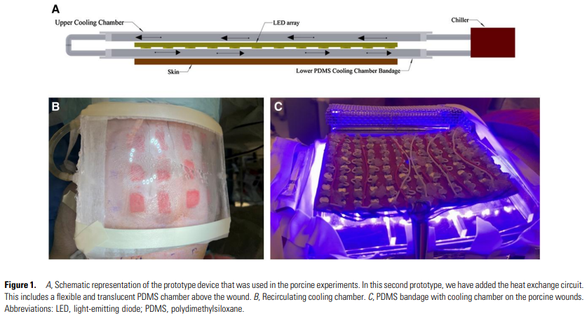
An Antimicrobial Blue Light Prototype Device Controls Infected Wounds in a Preclinical Porcine Model
Treating skin wounds with ABL
Partial-thickness surgical wounds created in live swine
Heavily contaminated and left untreated for 24 hours with MRSA ABL treatment stabilized and reduced MRSA infection by greater than 4 orders of magnitude (>99.99%; P < .0001) compared with untreated wounds in the same animal, after only 2 daily treatments
ABL, with or without concomitant administration of negative pressure, antimicrobials, or photosensitizers, could play an important role in modern wound care by reducing the amount, duration, and cost of antibiotics needed, helping reduce antimicrobial resistance.
Laisa Bonafim Negri JID 2025:231 (15 March) • e545

Slide 27

Thank you
Follow EUCIC on Bluesky : @eucic.bsky.social
X
@EUCIC1

