Slide 1


The current literature in
Infection Prevention and Control
December 2023
By Gabriel Birgand

Slide 2

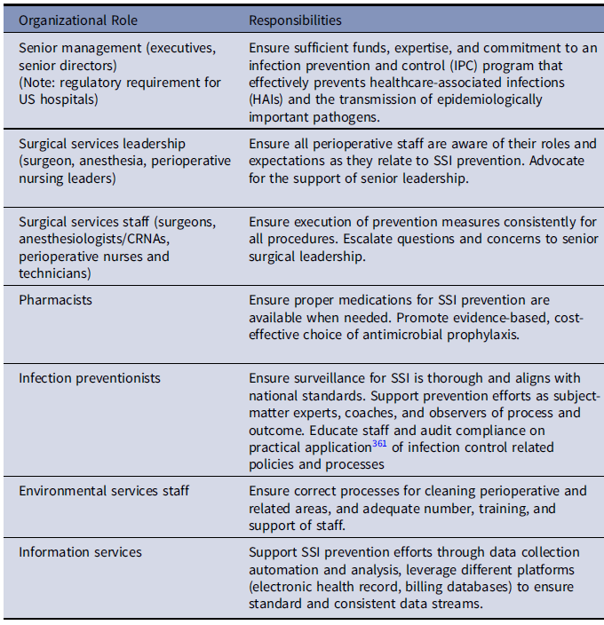
Strategies to prevent surgical site infections in acute-care hospitals: 2022 Update
Who is doing what?
Essential practices
Control blood-glucose during immediate postop for all patients
Parenteral + oral antimicrobial prophylaxis prior colorectal surg
Decolonize with anti-staphylococcal agent in the preoperative setting for orthopedic and cardiothoracic procedures
All procedures involving prosthetic material
Vaginal preparation agents for patients undergoing cesarean delivery or hysterectomy
Perform intraoperative antiseptic wound lavage.
Use a checklist and/or bundle to ensure compliance
Provide ongoing SSI rate feedback
Additional approaches
Use of negative pressure dressings
Use antiseptic-impregnated sutures
Should not be considered: vancomycin dor SAP
Unresolved issues: oxygenation, antimicrobial powder, surgical attire
Michael S. Calderwood, Infection Control & Hospital Epidemiology (2023), 1–26 doi:10.1017/ice.2023.67

Slide 3

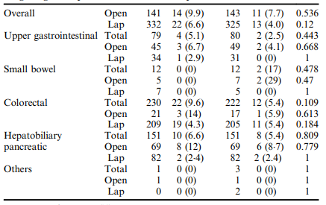
Aqueous povidone-iodine versus normal saline for intraoperative wound irrigation on the incidence of SSI in clean-contaminated wounds after gastroenterological surgery
Randomized, blinded-endpoint trial (1:1), hospital Japan
Elective gastroenterological surgery.
Intraoperative wound irrigation
1 min 40 mL aqueous PVP-I 10%
1 min 100 mL saline
SSI 30 days
Assumption 50% reduction
4.7% SSI intervention vs 9.4% control
930 patients with 80% power, risk α 0,05
June 2019, March 2022
473 patients PVI aqueous PVP-I 10%
468 patients saline
 | 10% PVP-I | Saline | RR
SSI | 36 (7.6) | 24 (5.1) | 1.5 (0.9 - 2.5)
SSI sup | 31 (6.6) | 20 (4.3) | 1.5 (0.9 - 2.6)
SSI deep | 5 (1.0) | 4 (0.8) | 1.2 (0.3 - 4.6)
Intervention
Control
SSI
SSI
p
70% Laparo
Recommendation of IOWI with aqueous PVP-I
should be Reconsidered
Ryo Maemoto Annals of Surgery 277(5):p 727-733, May 2023. | DOI: 10.1097/SLA.0000000000005786

Slide 4
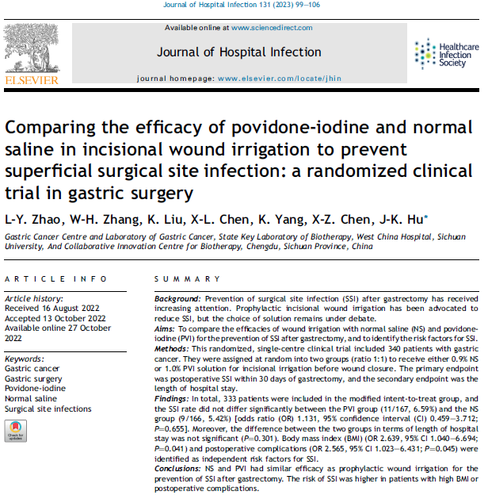
Aqueous povidone-iodine versus normal saline for intraoperative wound irrigation on the incidence of SSI in clean-contaminated wounds after gastroenterological surgery
randomized, blinded-endpoint trial (1:1), hospital Japan
Elective gastroenterological surgery.
Intraoperative wound irrigation
1 min 40 mL aqueous PVP-I 10%
1 min 100 mL saline
SSI 30 days
Assumption 50% reduction
4.7% SSI intervention vs 9.4% control
930 patients with 80% power, risk α 0,05
June 2019, March 2022
473 patients PVI aqueous PVP-I 10%
468 patients saline
 | 10% PVP-I | Saline | RR
SSI | 36 (7.6) | 24 (5.1) | 1.5 (0.9 - 2.5)
SSI sup | 31 (6.6) | 20 (4.3) | 1.5 (0.9 - 2.6)
SSI deep | 5 (1.0) | 4 (0.8) | 1.2 (0.3 - 4.6)
Intervention
Control
SSI
SSI
p
70% Laparo
Recommendation of IOWI with aqueous PVP-I
should be Reconsidered
Ryo Maemoto Annals of Surgery 277(5):p 727-733, May 2023. | DOI: 10.1097/SLA.0000000000005786

Slide 5

Rituals and behaviours in the operating theatre – joint guidelines of The HIS and The ESCMID.
Objective: to debunk some of the practices
Allow clean beds with fresh, clean linen brought into OR directly from clinical areas.
No need to place patients with suspected/confirmed contact transmissible MDRO infection/colonisation at the end of an operating list as long as the OR is cleaned and disinfected to standard between patients and the theatre ventilation is running without interruption.
Allow patients with isolation/contact precautions to recover in the OR or in a designated section of the recovery area.
For all surgical/operative procedures, lay up the instruments and prosthetic materials as close as possible to when they are needed.
For ultraclean ventilation OT, lay up the instruments/prosthetic materials under the canopy unless there happens to be UCV in the preparation room, which is an alternative.
Minimise non-essential staff movement and hence door openings during surgical procedures to minimise bacterial air counts.
Change or cover OT attire (e.g. with a single-use disposable gown) and change footwear if leaving the OT complex with the intention of returning.
Refer to current hospital policy for pre-operative patient management, although be aware that covering patients’ hair is not required for infection prevention reasons
Hilary Humphreys, Journal of Hospital Infection 2023
https://doi.org/10.1016/j.jhin.2023.06.009

Slide 6

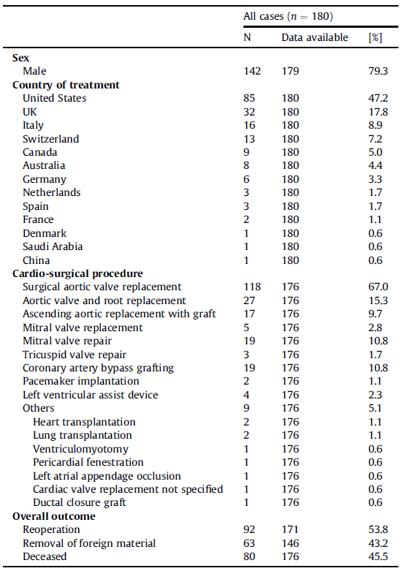
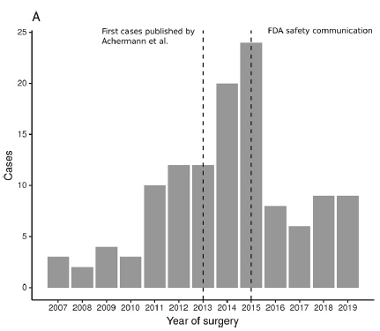
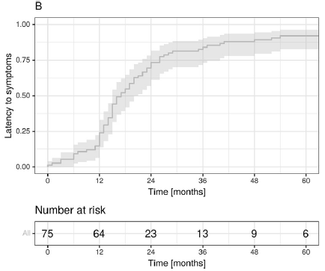
Clinical characteristics and outcome of Mycobacterium chimaera infections after cardiac surgery: systematic review of 180 heater-cooler unit-associated cases
Searched PubMed and the Web of Science until 15 June 2022 for case reports, case series, and cohort studies
Number of patients suffering from heater-cooler unit-associated M. chimaera infection
Latency to the first clinical symptoms
Reoperation seems to be associated with better survival. Physicians have to stay aware of this infection, as patients might still be present today due to the long latency period.
Nils Wetzstein Clinical Microbiology and Infection 29 (2023) 1008e1014
https://doi.org/10.1016/j.cmi.2023.03.005

Slide 7


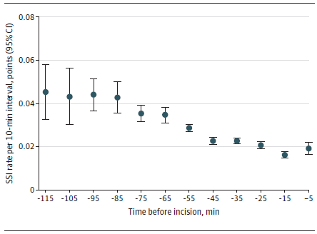
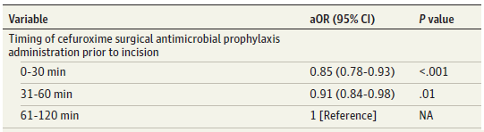
Timing of Cefuroxime Surgical Antimicrobial Prophylaxis and Its Association With Surgical Site Infections
Objective: To assess whether earlier vs later timing of administration of cefuroxime SAP is associated with the occurrence of SSI
Methods: Adult patients who underwent 1 of 11 major surgical procedures with cefuroxime SAP, in the Swissnoso SSI surveillance, between January 2009 and December 2020 at 158 Swiss hospitals.
Crude Surgical SSI Rate Relative to Timing of SAP
2.4% Global SSI rate (5355 patients)
0 to 30 min: 1.9% (1468 patients)
31 to 60 min: 2.4% (2873 patients)
61 to 120 min: 3.7% (1013 patients)
Administration of cefuroxime SAP closer to the incision time was associated with significantly lower odds of SSI, suggesting that cefuroxime SAP should be administrated within 60 minutes prior to incision, and ideally within 10 to 25 min
Rami Sommerstein, JAMA Network Open. 2023;6(6):e2317370. doi:10.1001/jamanetworkopen.2023.17370

Slide 8

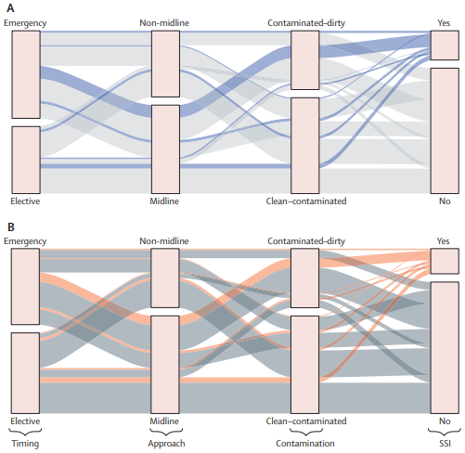
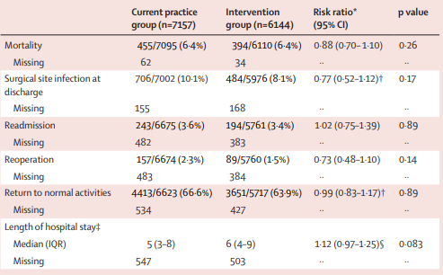
Routine sterile glove and instrument change at the time of abdominal wound closure to prevent SSI (ChEETAh)
Objective: to test whether a routine change of gloves and instruments before wound closure reduced abdominal SSI
Methods: multicentre, cluster randomised trial in seven low-income and middle-income countries
Between June 24, 2020 and March 31, 2022, 81 clusters were randomly assigned
current practice (42) versus intervention (39); routine change of gloves and instruments before wound closure for the whole scrub team).
Flow of patients across key surgical features.
SSIs diagnosed within each patient group highlighted in blue for the current practice group (A) and orange for the intervention group (B).
Robust benefit to routinely changing gloves and instruments before abdominal wound closure
NIHR Global Research Lancet 2022; 400: 1767–76 https://doi.org/10.1016/S0140-6736(22)01884-0

Slide 9

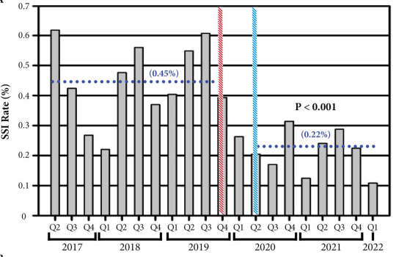
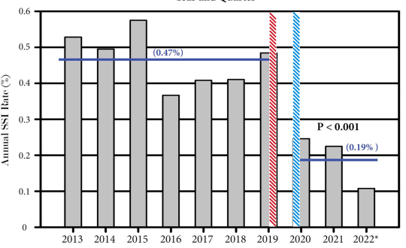
Improvement of Operating Room Air Quality and Sustained Reduction of Surgical Site Infections in an Orthopedic Specialty Hospital
Objective: Impact of high-efficiency particulate air and ultraviolet air recirculation system devices on SSI rates when used at an orthopedic specialty hospital
30,000 consecutive procedures from 2017 to 2022 for nervous system procedures or for all procedures
Hatched red line indicates when HUAIRS were implemented in all 5 OR used for spinal procedure
hatched blue line indicates when HUAIRS was implemented in all 10 ORs at the facility
Implementation of HUAIRS devices at an orthopedic specialty hospital is associated with significant reductions in SSI rates and intraoperative air contamination levels.
Anildaliz Navedo Mullen AJIC 2023
https://doi.org/10.1016/j.ajic.2023.05.018

Slide 10

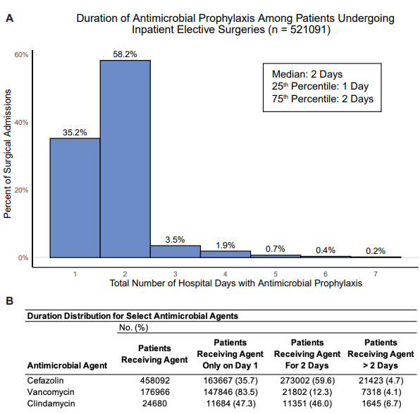
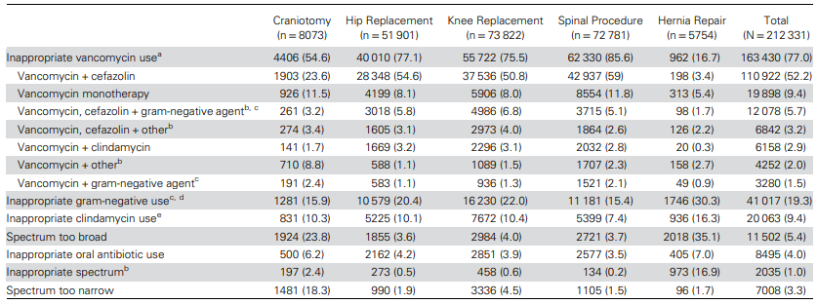
Adherence to Antimicrobial Prophylaxis Guidelines for Elective Surgeries across 825 United States Hospitals, 2019-2020
Retrospective cohort study of adults who underwent elective craniotomy, hip/knee replacement, spinal procedure, or hernia repair in 2019–2020 at hospitals in the PINC AI (Premier) Healthcare Database
Reason(s) for Guideline Nonadherence Across
212 331 Nonadherent Elective Surgical Procedures, by Surgery Type
59% were adherent to prophylaxis guidelines
Unnecessary vancomycin use, which may increase the risk of AKI
Stephanie M Cabral CID 2023
DOI: 10.1093/cid/ciad077

Slide 11

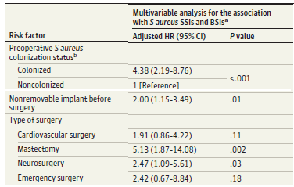
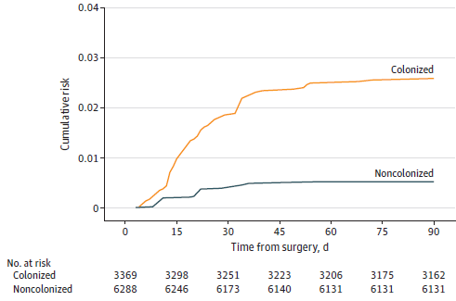
Postoperative Staphylococcus aureus Infections in Patients With and Without Preoperative Colonization
To assess the occurrence of postoperative S aureus SSIs and BSIs and quantify its association with patient-related and contextual factors
33 hospitals in 10 European countries, December 16, 2016, and September 30, 2019
5004 patients, 3369 (67.3%) S aureus carriers; 100 S aureus SSIs or BSIs within 90 days after surgery.
Weighted cumulative incidence of S aureus SSIs or BSIs Carriers: 2.55% (2.05%-3.12%) carriers
Noncarriers 0.52%(0.22%-0.91%)
S. aureus carriage associated with an increased risk of developing S aureus SSIs and BSIs, and with modifiable & nonmodifiable etiologic factors
JAMA Network Open. 2023;6(10):e2339793. doi:10.1001/jamanetworkopen.2023.39793

Slide 12

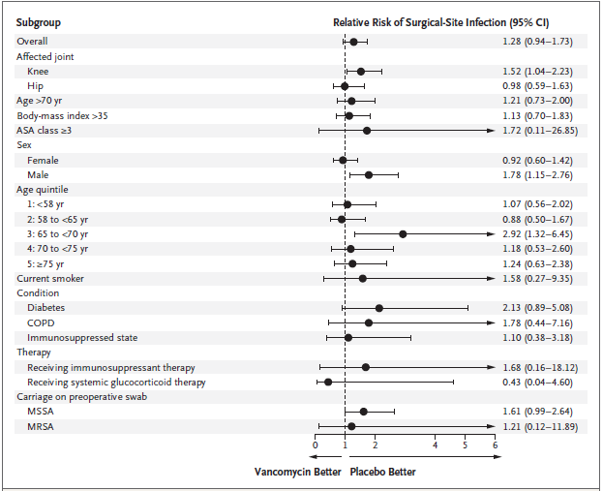
Trial of Vancomycin and Cefazolin as Surgical Prophylaxis in Arthroplasty
Multicenter, double-blind, superiority, placebo-controlled trial
Adult patients without known MRSA colonization, arthroplasty,
1.5 g of vancomycin or normal saline placebo, + cefazolin prophylaxis
4113 patients in the modified intention-to-treat population
2233 undergoing knee arthroplasty,
1850 undergoing hip arthroplasty,
30 undergoing shoulder arthroplasty
Vanco group: 4.5% SSI
Knee: 5.7%, Hip: 3%
Placebo group: 3.5%, RR: 1.28; 0.94-1.73; P = 0.1
Knee: 3.7%, Hip: 3.1%
Addition of vancomycin to cefazolin prophylaxis was not superior to placebo among patients without known MRSA colonization
N Engl J Med 2023;389:1488-98.
DOI: 10.1056/NEJMoa2301401

Slide 13

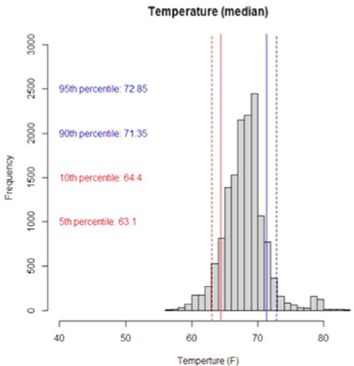
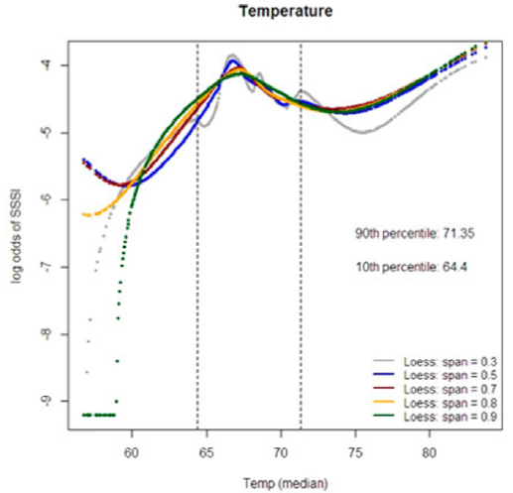
The influence of operating room temperature and humidity on surgical site infection: A multisite ACS-NSQIP analysis
All operations at 3 centers reported to the ACS-NSQIP (2016e2020)
Ambient intraoperative temperature (⁰F) + relative humidity (RH) recorded in 15-min intervals.
14,519 operations analyzed with 179 SSIs (1.2%)
Significant deviations in intraoperative temperature/humidity are not associated with increased risk of SSI
Jacob B. Hammond, Am Journ Surg 2023
https://doi.org/10.1016/j.amjsurg.2023.06.039

Slide 14
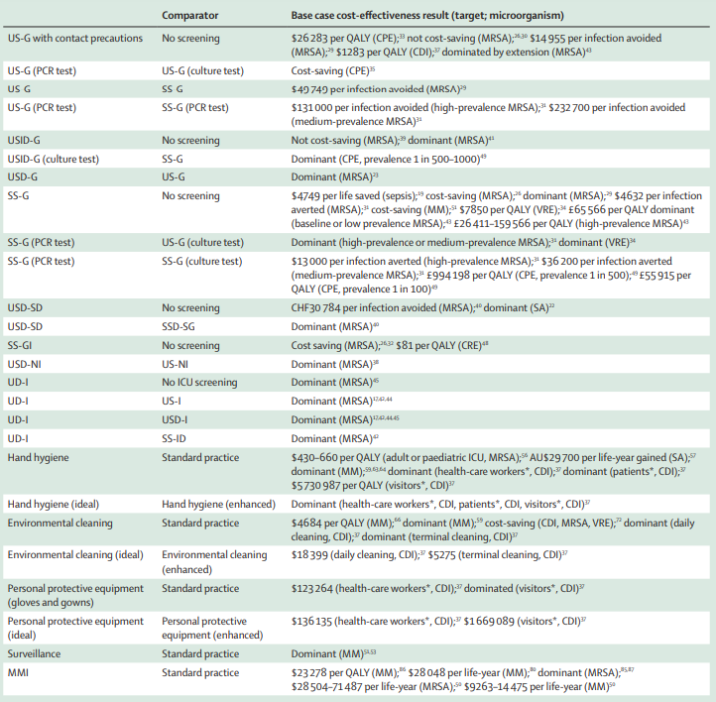
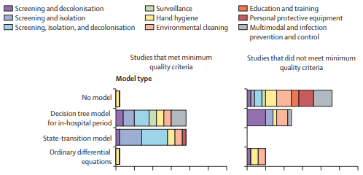
Economic evaluations of interventions to prevent and control health-care-associated infections: a systematic review
Objective: systematic review to review the cost-effectiveness of interventions to limit the spread of HAI, framed by WHO infection prevention and control core components
Interventions including hand hygiene, personal protective equipment, national-level or facility-level infection prevention and control programmes, education and training programmes, environmental cleaning, and surveillance.
BMJ checklist was used to assess the quality of economic evaluations.
Ccost-effectiveness results for studies meeting the minimum quality criteria
67 studies were included in the review
Some evidence that hand hygiene, environmental cleaning, surveillance, and multimodal interventions were cost-effective.
Few or no studies investigating education and training, PPE or monitoring, and evaluation of interventions.
Lancet Infect Dis 2023; 23: e228–39, https://doi.org/10.1016/S1473-3099(22)00877-5

Slide 15
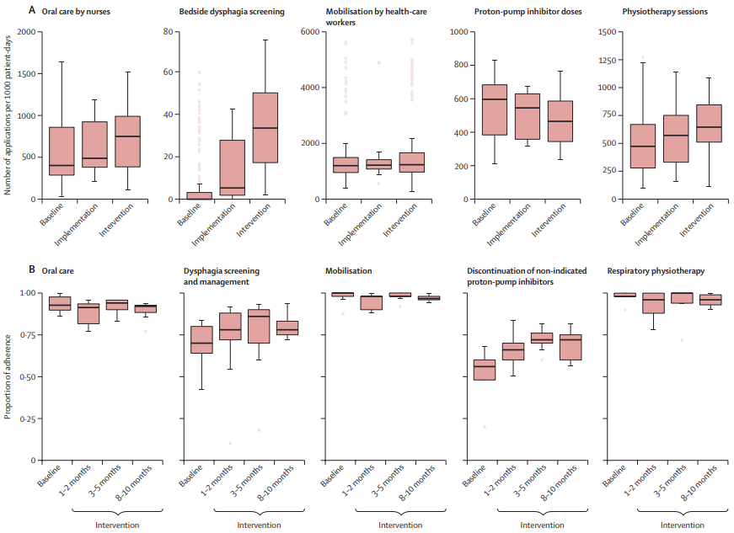
Prevention of non-ventilator-associated hospital-acquired pneumonia in Switzerland: a type 2 hybrid effectiveness– implementation trial
Objective: to test an Non-ventilator-associated hospital-acquired pneumonia (nvHAP) prevention intervention + multifaceted implementation strategy
Methods: single-centre, type 2 hybrid effectiveness–implementation study
Patients 9 surg./med. dept, Univ. Hosp. Zurich, Switzerland
5-measure nvHAP prevention bundle:
Oral care, dysphagia screening and management, mobilisation, discontinuation of non-indicated proton-pump inhibitors, and respiratory therapy
Department-level implementation teams 3
Locally adapted core strategies of education, training, and changing infrastructure
Primary outcome: nvHAP incidence rate
451 nvHAP cases between Jan 1, 2017-Feb 29, 2020 during 361 947 patient-days
The prevention bundle led to a reduction of nvHAP. Knowledge of the determinants of implementation success might help in upscaling nvHAP prevention.
Aline Wolfensberger Lancet Infect Dis 2023; 23: 836–46
https://doi.org/10.1016/S1473-3099(22)00812-X

Slide 16
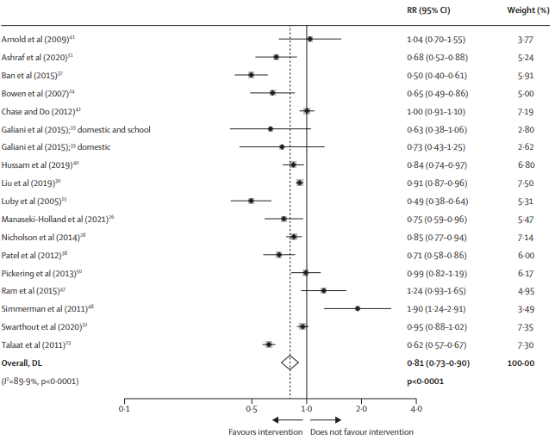
Effectiveness of handwashing with soap for preventing acute respiratory infections in LMICs
Any acute respiratory infection, for which handwashing comprised the majority of intervention
Systematic review and meta-analysis randomised and non-randomised controlled studies of interventions conducted in domestic, school, or childcare settings
Interventions promoting hand hygiene methods other than handwashing with soap were excluded, as were interventions in health-care facilities or the workplace.
26 studies with 161 659 participants met inclusion criteria,
Interventions promoting handwashing with soap reduced
RR 0·83 [95% CI 0·76–0·90]: any ARI compared with no handwashing
0·78 [0·64–0·94]: lower respiratory infections
0·74 [0·59–0·93]: upper respiratory infections
0·94 [0·42–2·11]: but not test-confirmed influenza test-confirmed COVID-19 (no comparisons), or all-cause mortality (prevalence ratio 0·95 [95% CI 0·71–1·27]; one comparison).
Interventions promoting handwashing with soap can reduce ARI in LMICs, and could help to prevent the large burden of respiratory disease
Ian Ross Lancet 2023; 401: 1681–90
https://doi.org/10.1016/S0140-6736(23)00021-1

Slide 17
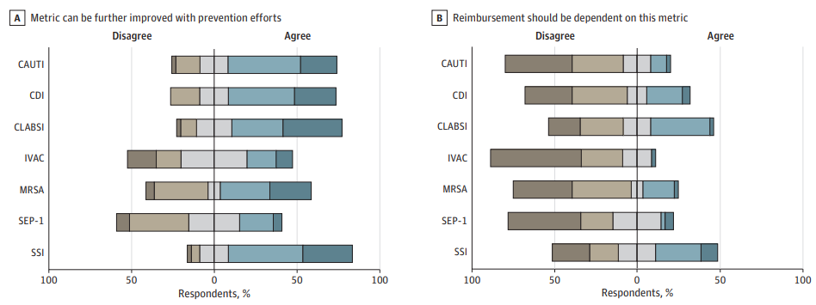
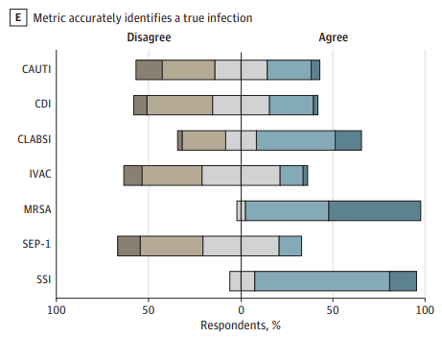
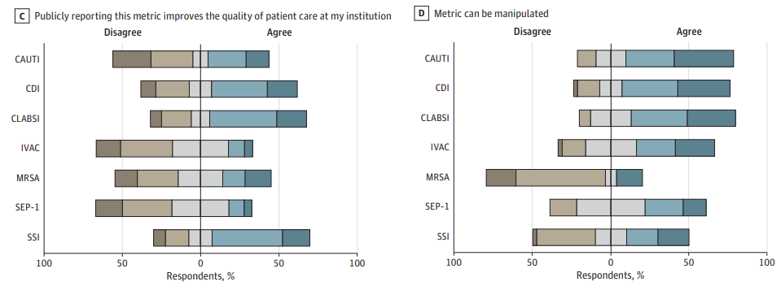
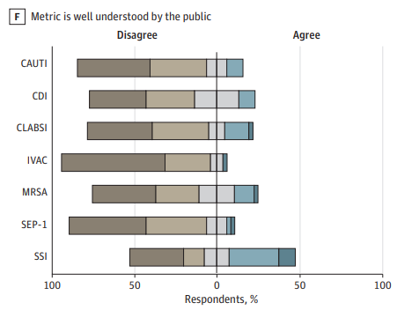
Perceptions of Health Care–Associated Infection Metrics by Infection Control Experts
IC experts at 43 institutions completed a survey to evaluate perceptions of commonly reported HAI measures
GregoryM. Schrank, JAMA Network Open. 2023;6(4):e238952. doi:10.1001/jamanetworkopen.2023.8952

Slide 18
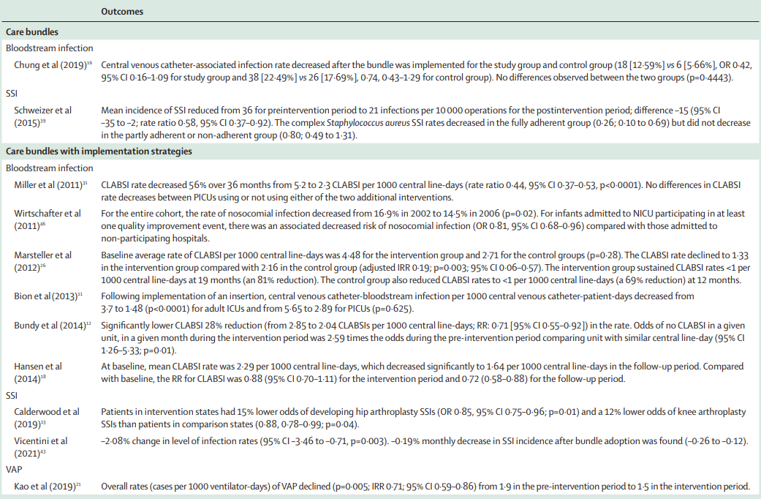
Effectiveness of national and subnational interventions for prevention and control of HAI in acute hospitals in high-income and upper-middle-income counties
Systematic review, commissioned and funded by WHO: 36 studies
Best available evidence supports the effectiveness of nationally or subnationally driven care bundle interventions paired with implementation strategies in reducing HAI in acute hospitals
Inconclusive evidence for national regulations and IPC programmes
Further research needs on LMICs, IPC intervention at national or subnational level using robust study designs
Flexible, pragmatic approach, allows for tailoring IPC programmes to the specific contexts, settings, and populations is encouraged
Lesley Price Lancet Infect Dis 2023
https://doi.org/10.1016/S1473-3099(23)00049-X

Slide 19
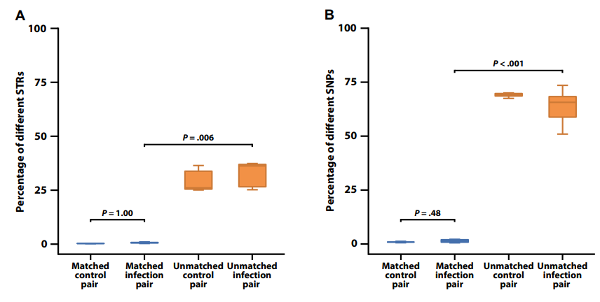
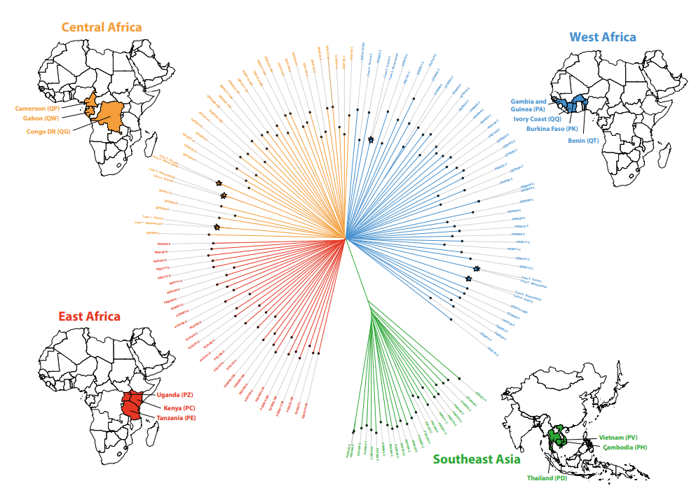
Nosocomial Malaria Transmissions Resolved by Genomic Analyses—A Retrospective Case Report Study in France: 2007–2021
Between 2007 & 2021: 6 autochthonous malaria cases in different French hospitals
From nosocomial transmission and imported malaria cases being the infection source
None of the patients with autochthonous malaria had travel history to an endemic area nor had been transfused.
For each case, both the source and recipient patients stayed a few hours in the same ward.
Each pair of matched source/nosocomial parasite infections: <1% of different STRs and <6.9% of SNPs
Comparison of genome-wide STRs and SNPs across matched and unmatched infection and control pairs
Star are the pairs
Phylogenetic tree of parasites from imported & nosocomial infections, with 125 African and Asian parasites from MalariaGEN
Nosocomial transmission via blood of more common pathogens, in particular bacteria, may be frequent
Romain Coppée CID 2023; https://doi.org/10.1093/cid/ciac813

Slide 20
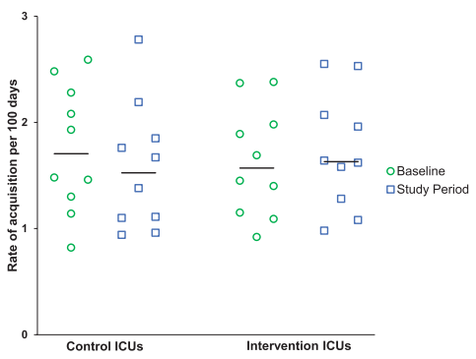
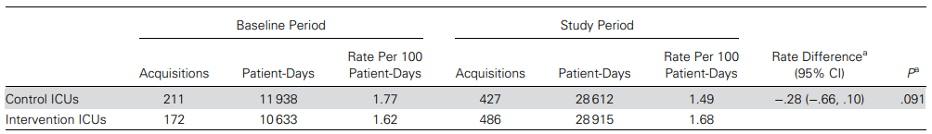
The Impact of Universal Glove and Gown Use on Clostridioides Difficile Acquisition: A Cluster-Randomized Trial
Secondary analysis of cluster-randomized trial, 20 medical/surgical ICUs in 20 US hospitals in 2012
ICUs randomized: standard practice vs gloves and gowns for all patient contact & at room entry
Primary outcome: acquisition of toxigenic C. difficile determined by cultures on admission and discharge.
21 845 patients both admission and discharge cultured for toxigenic C. difficile.
9.43% (2060/21 845) positive for toxigenic C. difficile on admission
6.6% (1296/19 785) negative on admission acquired C. difficile
No evidence of impact of universal gown and glove on acquisition rates of toxigenic C. difficile or ribotype 027–like C. difficile
Other factors associated with C. difficile acquisition included C. difficile colonization pressure in the ICU, self-reported high compliance with gown and glove use, time of year
Daniel J. Morgan CID 2023:76 (1 February)
https://doi.org/10.1093/cid/ciac519

Slide 21
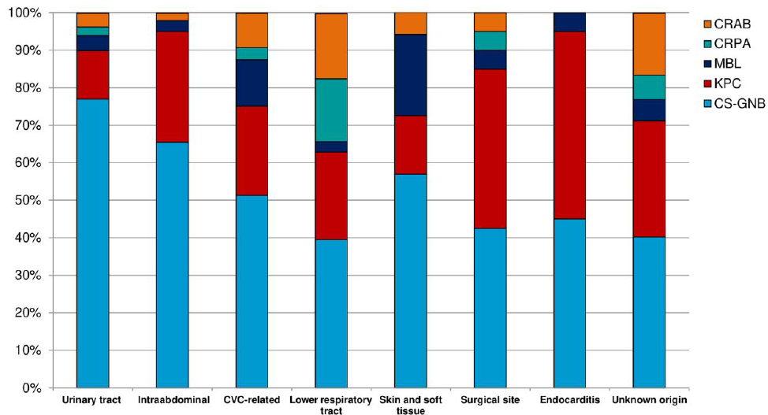
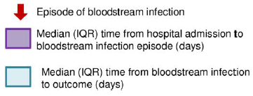
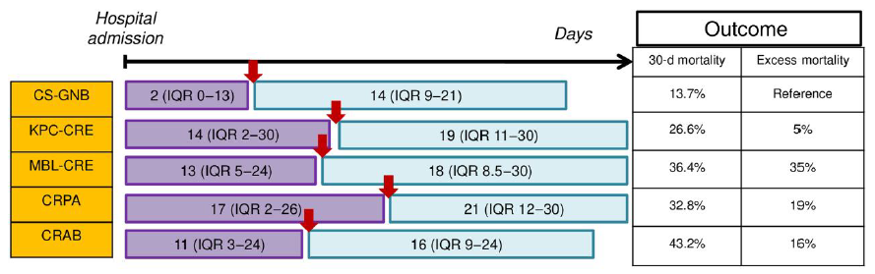
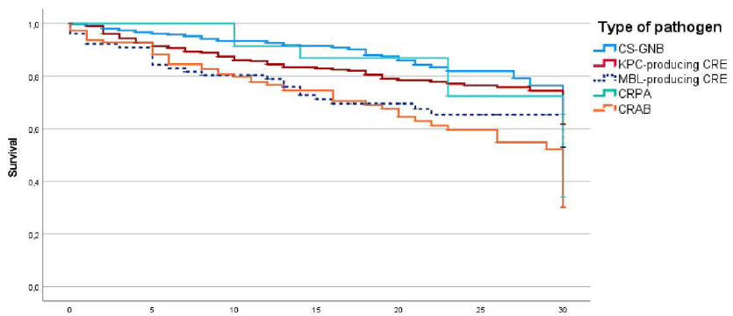
Mortality Attributable to Bloodstream Infections Caused by Different Carbapenem-Resistant Gram-Negative Bacilli
1276 patients with monomicrobial GNB BSI from 19 Italian hospitals (June 2018–January 2020).
Primary outcomes: 30-day mortality
Attributable mortality was calculated according to the DRIVE-AB Consortium
Distribution of causative pathogens according to source of BSI
Attributable mortality rates were 5% for KPC-, 35% for MBL, 19% for CRPA, and 16% for CRAB.
Marco Falcone CID 2023;76(12):2059–69; https://doi.org/10.1093/cid/ciad100
Days

Slide 22
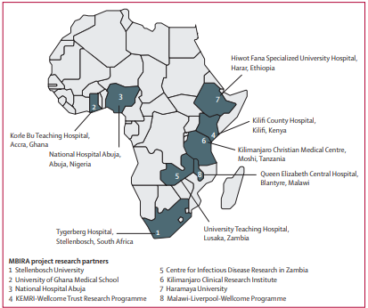
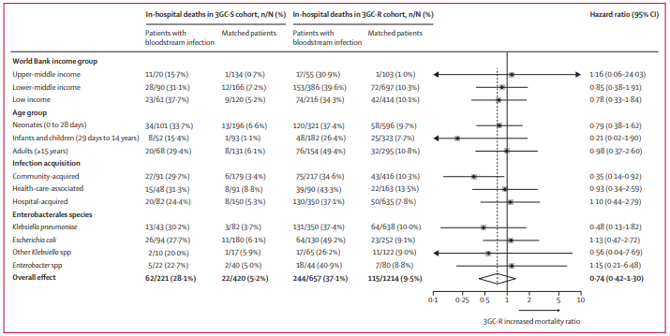
Mortality associated with third-generation cephalosporin resistance in Enterobacterales bloodstream infections at eight sub-Saharan African hospitals (MBIRA)
To measure the effects associated with resistance to 3GC in hospitalised patients with Enterobacterales bloodstream infection in Africa.
Prospective, matched, parallel cohort study at eight hospitals across sub-Saharan Africa, Nov 1, 2020, and Jan 31, 2022
Proportion of patients who died in hospital > in patients with BSI than in matched controls in the 3GC-S cohort (62 [28·1%] of 221 vs 22 [5·2%] of 420; and the 3GC-R cohort (244 [37·1%] of 657 vs
115 [9·5%] of 1214; 5·01 [3·96–6·32]). T
Alexander M Aiken Lancet Infect Dis July 13, 2023 https://doi.org/10.1016/S1473-3099(23)00233-5

Slide 23
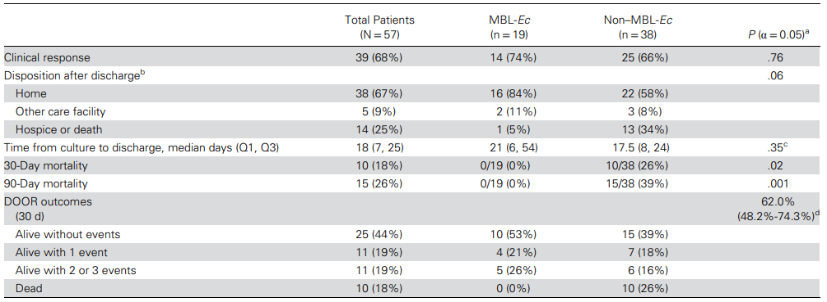
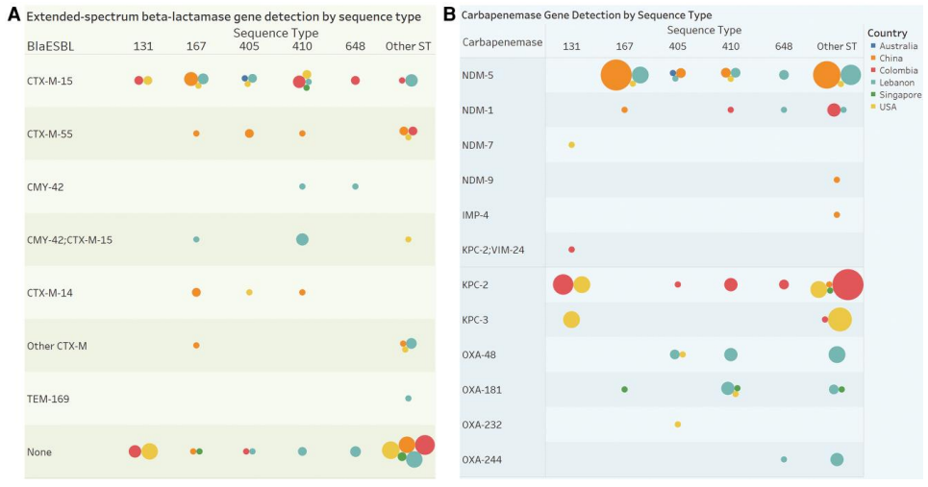
International epidemiology of carbapenemase-producing Escherichia coli
Objective: To describe the clinical and molecular epidemiology and outcomes of patients from several countries with CP-Ec isolates obtained from a prospective cohort
Patients with CP-Ec were enrolled from 26 hospitals in 6 countries, 114 CP-Ec isolates in CRACKLE-2, 49 harbored an MBL, most commonly blaNDM-5 (38/49, 78%).
Clinically, MBL-Ec were more often from urine source (49% vs. 29%), lower acuity of illness when compared to non-MBL-Ec
Emergence of CP-Ec was observed with important geographic variations
Mortality was higher among non-MBL isolates, which were more frequently isolated from blood
Angelique E Boutzoukas CID May DOI: 10.1093/cid/ciad288

Slide 24

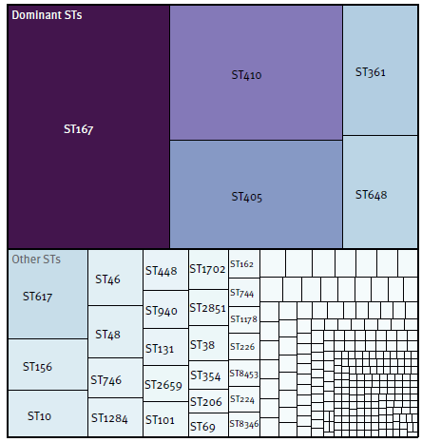
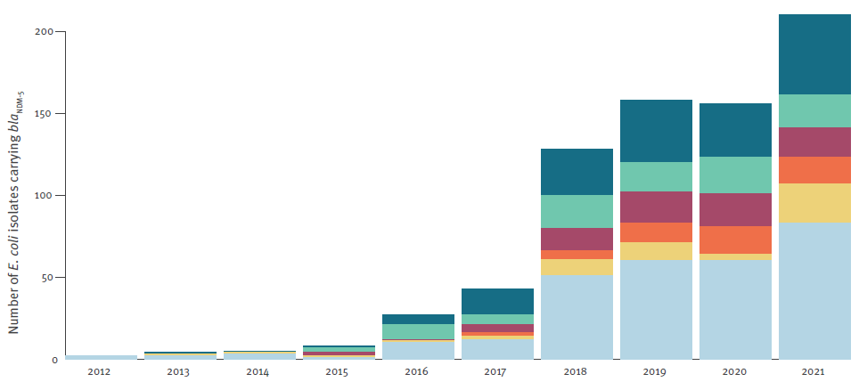

Rapid cross-border emergence of NDM-5-producing Escherichia coli in the European Union/European Economic Area, 2012 to June 2022
Whole genome sequencing data of 874 E. coli isolates carrying blaNDM-5 from 13 European Union
30.6% isolates associated with infections and 58.2% predicted to be multidrug-resistant.
Frequency of sequence types of E. coli isolates carrying bla NDM-5 over time by year of sampling in the dataset from national collections, EU/EEA, 2012–2021a (n = 741)
%
The spread of E. coli carrying bla NDM-5 is occurring rapidly and on a large geographical scale with a considerable risk for increasing carbapenem resistance in E. coli in the EU/EEA within a few years.
Marius Linkevicius EuroSurveill. 2023;28(19):pii=2300209. https://doi.org/10.2807/1560-7917.ES.2023.28.19.2300209

Slide 25
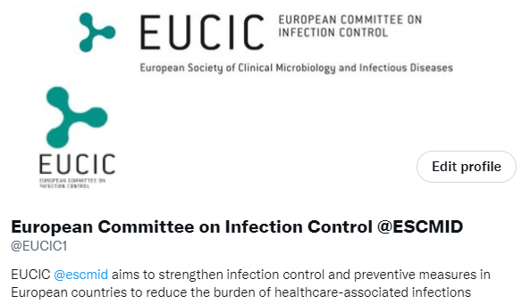
@EUCIC1

